Slide 1
Developing and evaluating your Extract, Transform, Load (ETL) process to the OMOP Common Data Model

Slide 2
What this tutorial will provide . . .
Suggested process for developing a CDM ETL
OHDSI ETL tools: White Rabbit, Rabbit-In-A-Hat
Resources like the Book of OHDSI and THEMIS
Generation of a simple ETL

Slide 3






Instructors
Clair Blacketer | Maxim Moinat | Max Natthawut Adulyanukosol
Evanette K. Burrows | Karthik Natarajan | Pusheen

Slide 4
Ground Rules
We built in some decent sized breaks, please return before time is up.
We may take some questions off-line if too specific.
Please be respectful of each other and our individual learning journeys.

Slide 5
Agenda
Time | Topic | Instructor | References
1:00 – 1:10 | Introduction | All
1:10 – 1:40 | OMOP CDM and Vocabularies | Karthik Natarajan | OMOP CDM Documentation THEMIS Repository Athena Vocabulary Browser
1:40 – 1:55 | Introduction to Synthea™ Data | Evanette Burrows | Synthea Native Data
1:55 – 2:05 | BREAK
2:05 – 3:20 | ETL Logic Walkthrough WhiteRabbit Rabbit-In-A-Hat PERSON OBSERVATION_PERIOD VISIT_OCCURRENCE CONDITION_OCCURRENCE DRUG_EXPOSURE | Clair Blacketer Evanette Burrows | WhiteRabbit Rabbit-In-A-Hat
3:20 – 3:30 | BREAK
3:30 – 3:50 | Generate a CDM/ ETL tools | Max | ETL-Synthea​
3:50 – 4:35 | Evaluate a CDM | Maxim Moinat | Achilles DataQualityDashboard ARES
Remaining Time | Q&A

Slide 6
Connecting to the Hotel WIFI
Network: OHDSI2025
Password: OHDSI2025

Slide 7
Foundational Concepts
Karthik

Slide 8
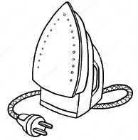
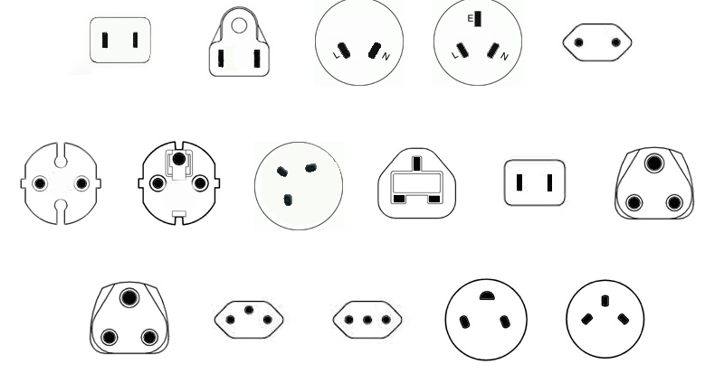
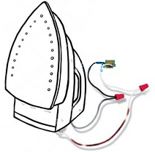
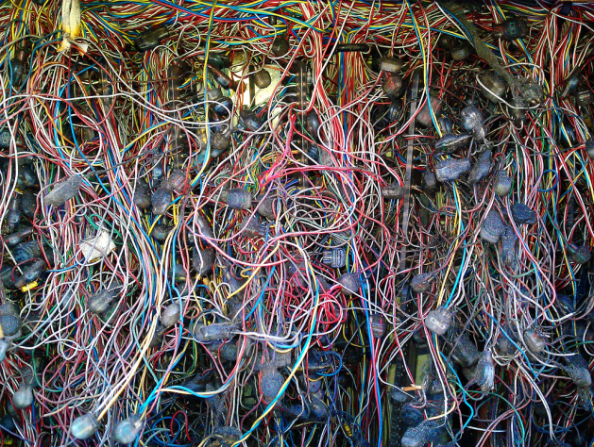
Current Approach: “One Study – One Script“
"What's the adherence to my drug in the data assets I own?"
Current solution:
Analytical method: Adherence to Drug
North America
Southeast Asia
China
Europe
UK
Japan
India
Application to data
Switzerland
Italy
So Africa
Israel
Not scalable
Expensive
Slow
Prohibitive to non-expert routine use
Custom script for each study

Slide 9
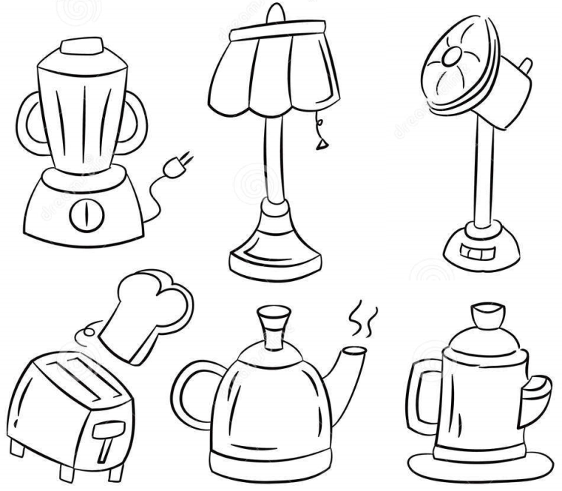


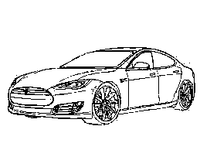
Solution: Standardized Data and Analytics
Adherence
Mortality
Source of Business
North America Southeast Asia China
Europe UK Japan India
So Africa Switzerland Italy Israel
Remote Studies
Safety Signals
Standardized data

Slide 10
What is the OMOP Vocabulary?

Slide 11
OMOP Common Vocabulary Model reference data for the OMOP CDM
What it is
Compiled standards from disparate public and private sources and some OMOP-grown concepts
Standardized structure to house existing vocabularies used in the public domain
What it’s not
Static dataset – the vocabulary updates regularly to keep up with the continual evolution of the sources
Finished product – vocabulary maintenance and improvement is ongoing activity that requires community participation and support

Slide 12
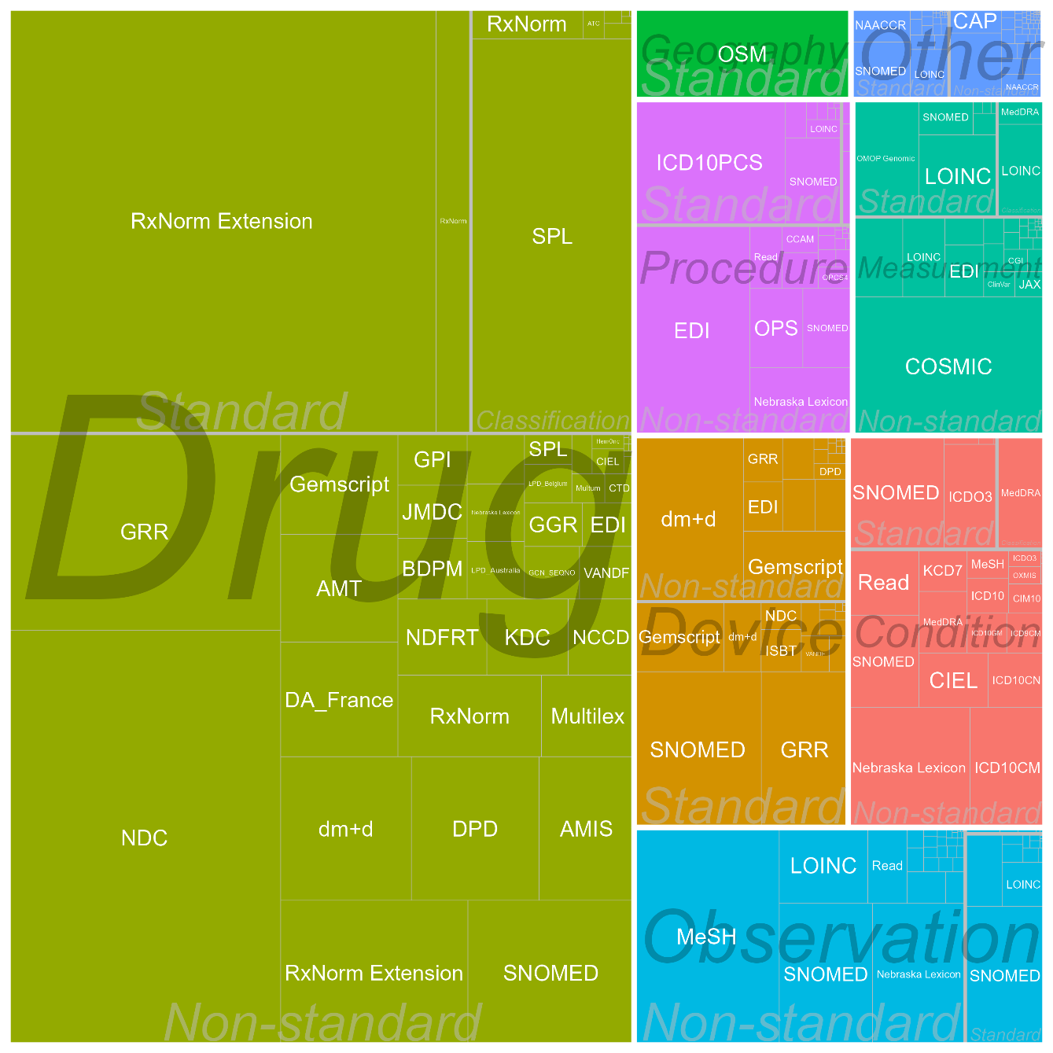
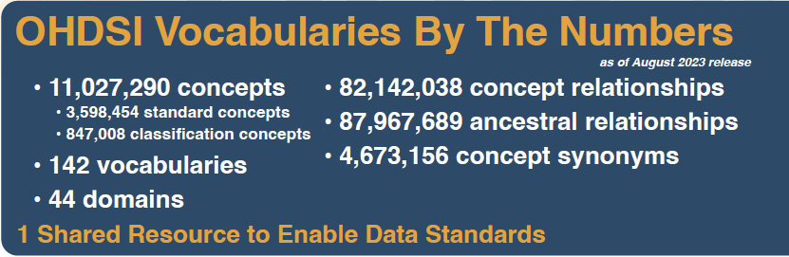
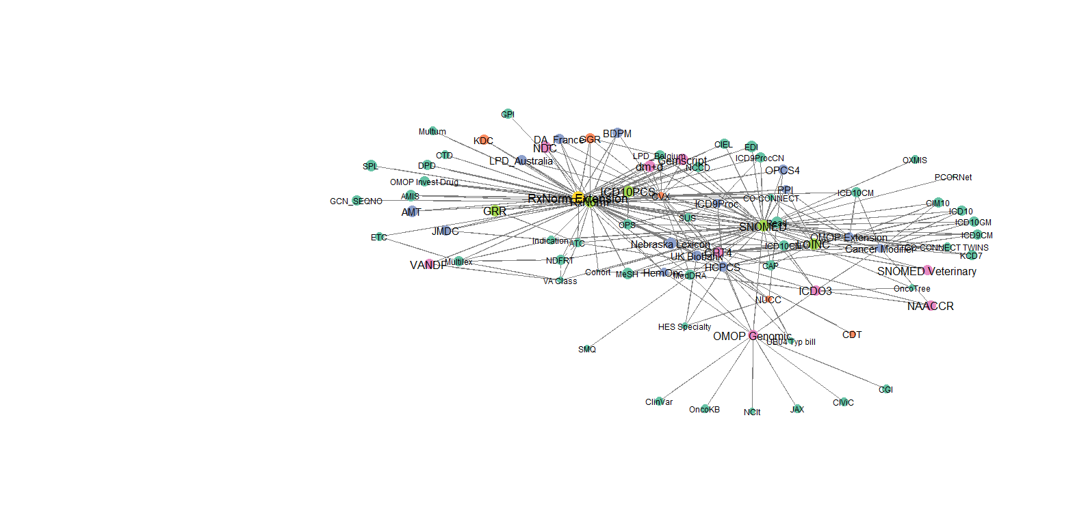
OHDSI Standard Vocabularies

Slide 13
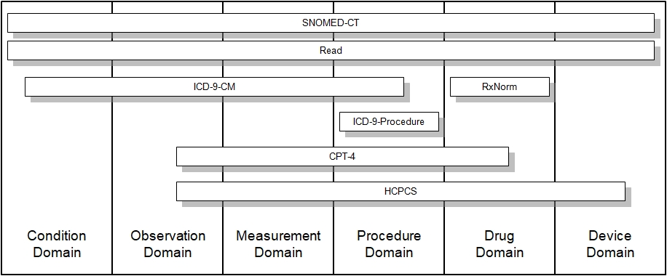
Domain and Vocabularies

Slide 14
What's in a Concept
For use in CDM
CONCEPT_ID | 313217
CONCEPT_NAME | Atrial fibrillation
DOMAIN_ID | Condition
VOCABULARY_ID | SNOMED
CONCEPT_CLASS_ID | Clinical Finding
STANDARD_CONCEPT | S
CONCEPT_CODE | 49436004
VALID_START_DATE | 01-Jan-1970
VALID_END_DATE | 31-Dec-2099
INVALID_REASON
English description
Domain
Vocabulary
Class in SNOMED
Concept in data
Code in SNOMED
Valid during time interval

Slide 15
OMOP Vocabulary Model Design Principles
Uniform structure
All concepts are in one table
All concept relationships are in one table, including mappings from source to standard vocabularies
Formalized integration with Common Data Model via concept domain
Direction of ETL is informed by concept domain
Relationships are bi-directional
Hierarchical relationships have additional representation in the model to support efficient data retrieval
https://github.com/OHDSI/Vocabulary-v5.0/wiki/Introduction​

Slide 16
Source Codes, Concepts and Mapping to Standard Concepts

Slide 17
The Source for Source Codes
May come from international terminology or code system
SNOMED, ICD10
1
May come from a country specific terminology or code system
Read, BDPM, ICD10CN, CVX
2
May be free text strings
Centimeter, Intravenous, Cigarette Smoker
3
May come from an EHR specific code system
Epic procedure codes: ‘L111’
4

Slide 18
Different Categories of Concepts
Non- standard Concepts
Standard Concepts
Classification
Concepts
Function
Unique representation of a source code
Function
Used for standardized analytics and by
OHDSI tools
Function
Used to perform hierarchical queries

Slide 19
Mapping non-standard concept_ids to standard concept_ids
CONCEPT RELATIONSHIP
Non-standard Concepts
Standard Concepts

Slide 20
Mapping Source Codes to Standard Concept_IDs

Slide 21
Source Codes Mapping – Scenario 1
Scenario
Solution
Source code is available in an OHDSI supported Vocabulary
Use using the following condition to perform the mapping:
Where <source code> = CONCEPT.concept_code and <source vocabulary> = CONCEPT.vocabulary_id
Source code | Source vocabulary | Code description | CONCEPT.concept_id
61462000 | SNOMED | Malaria | 438067
A663D00 | Read | Zika Fever | 45489770

Slide 22
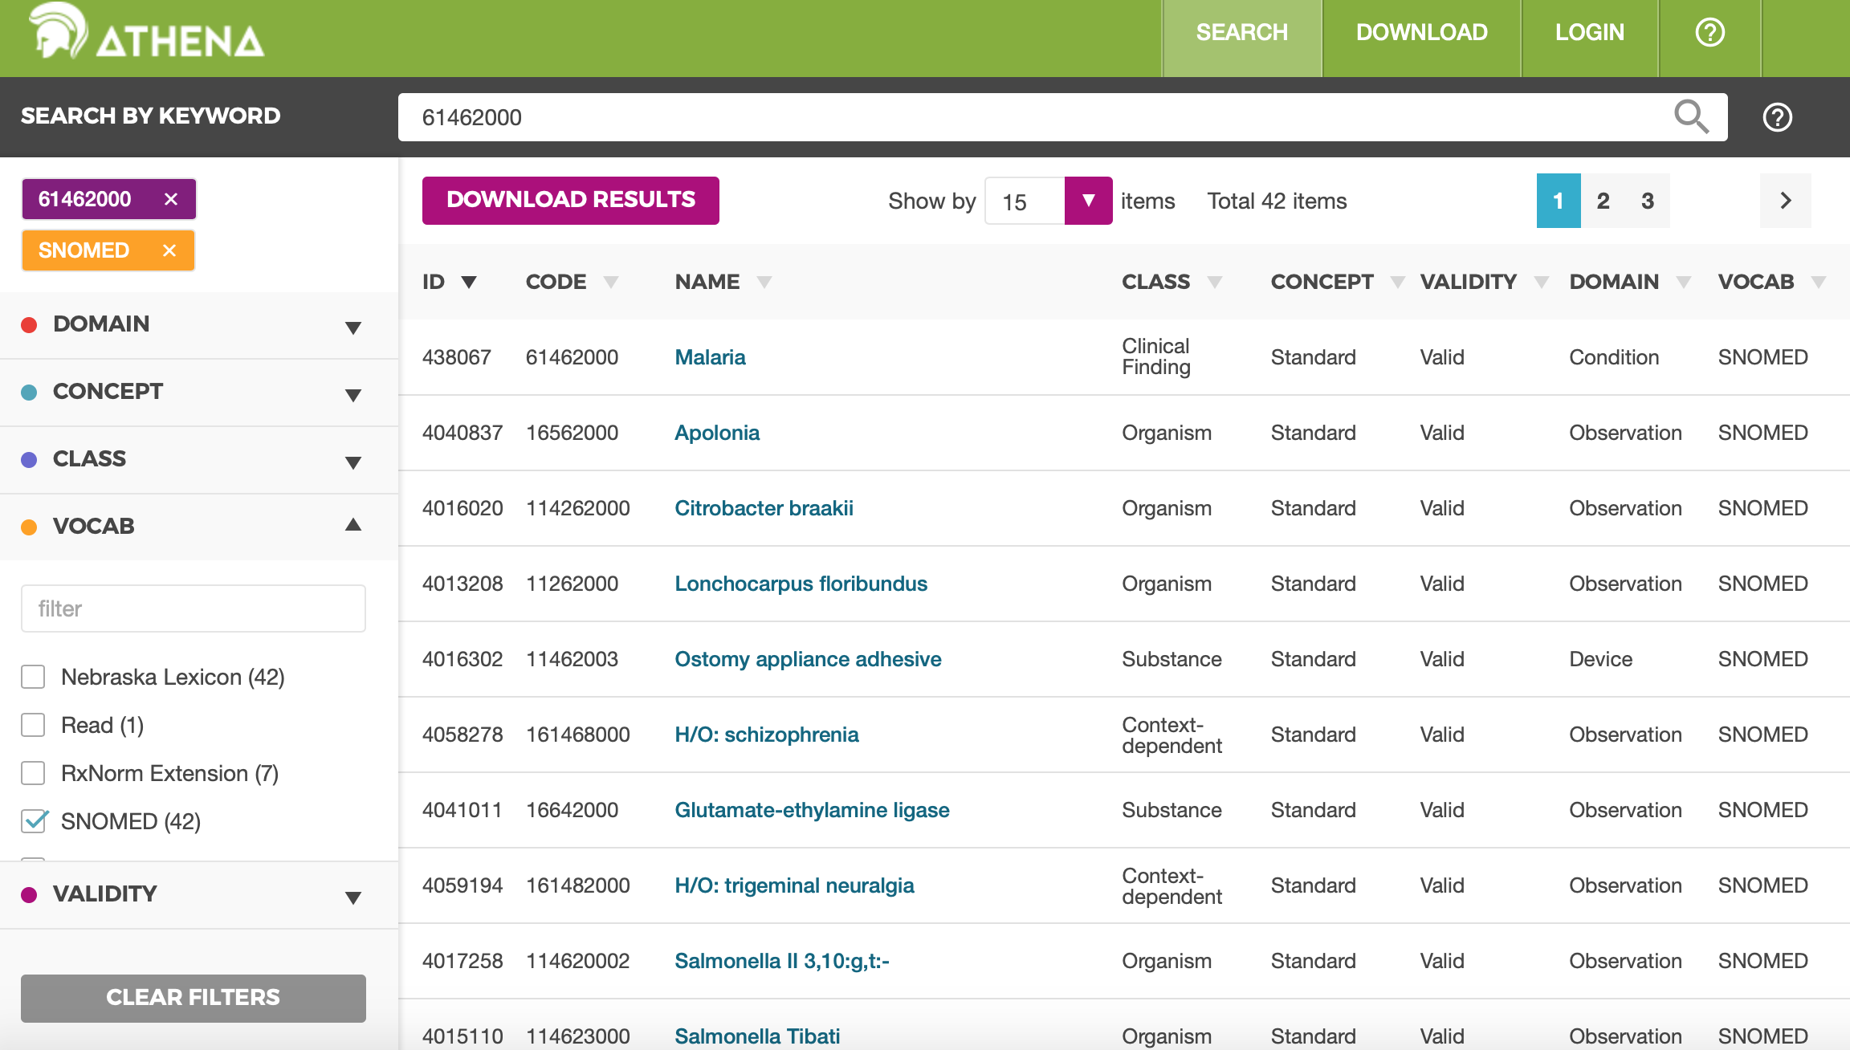

Slide 23
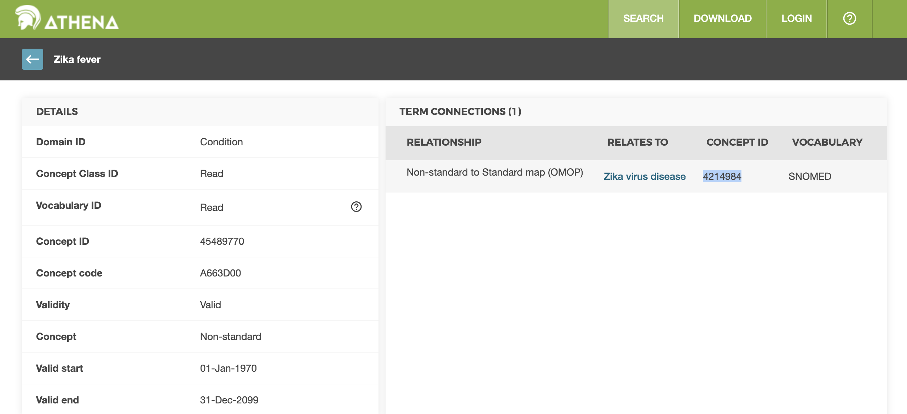

Slide 24
Source Codes Mapping – Scenario 2
Scenario
Solution
Source code is a text string
Use using the following condition to perform the mapping:
Where <source string> = CONCEPT.concept_name and <source domain> = CONCEPT.domain_id
Source string | Source domain | Source table/field | CONCEPT.concept_id
Centimeter | Unit | Unit for height measurement field | 8582
Intravenous | Route | Route for drug administration field | 4171047
EDD | Observation | Pregnancy data table | 3011536

Slide 25
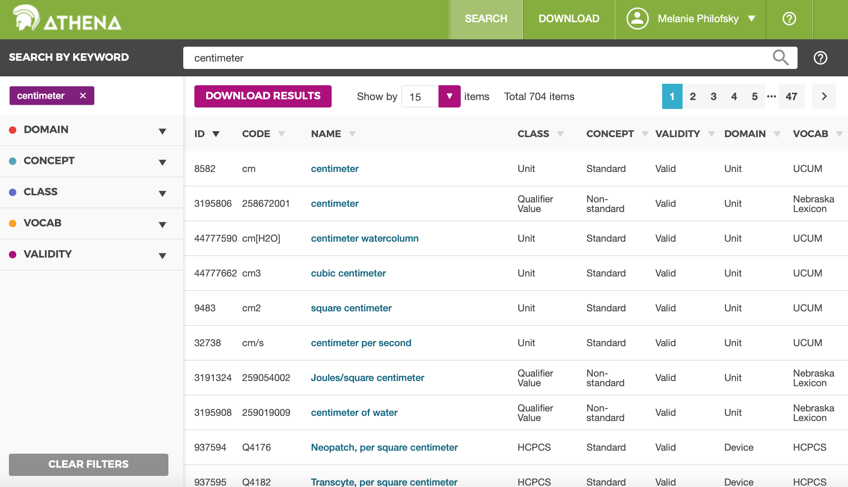

Slide 26
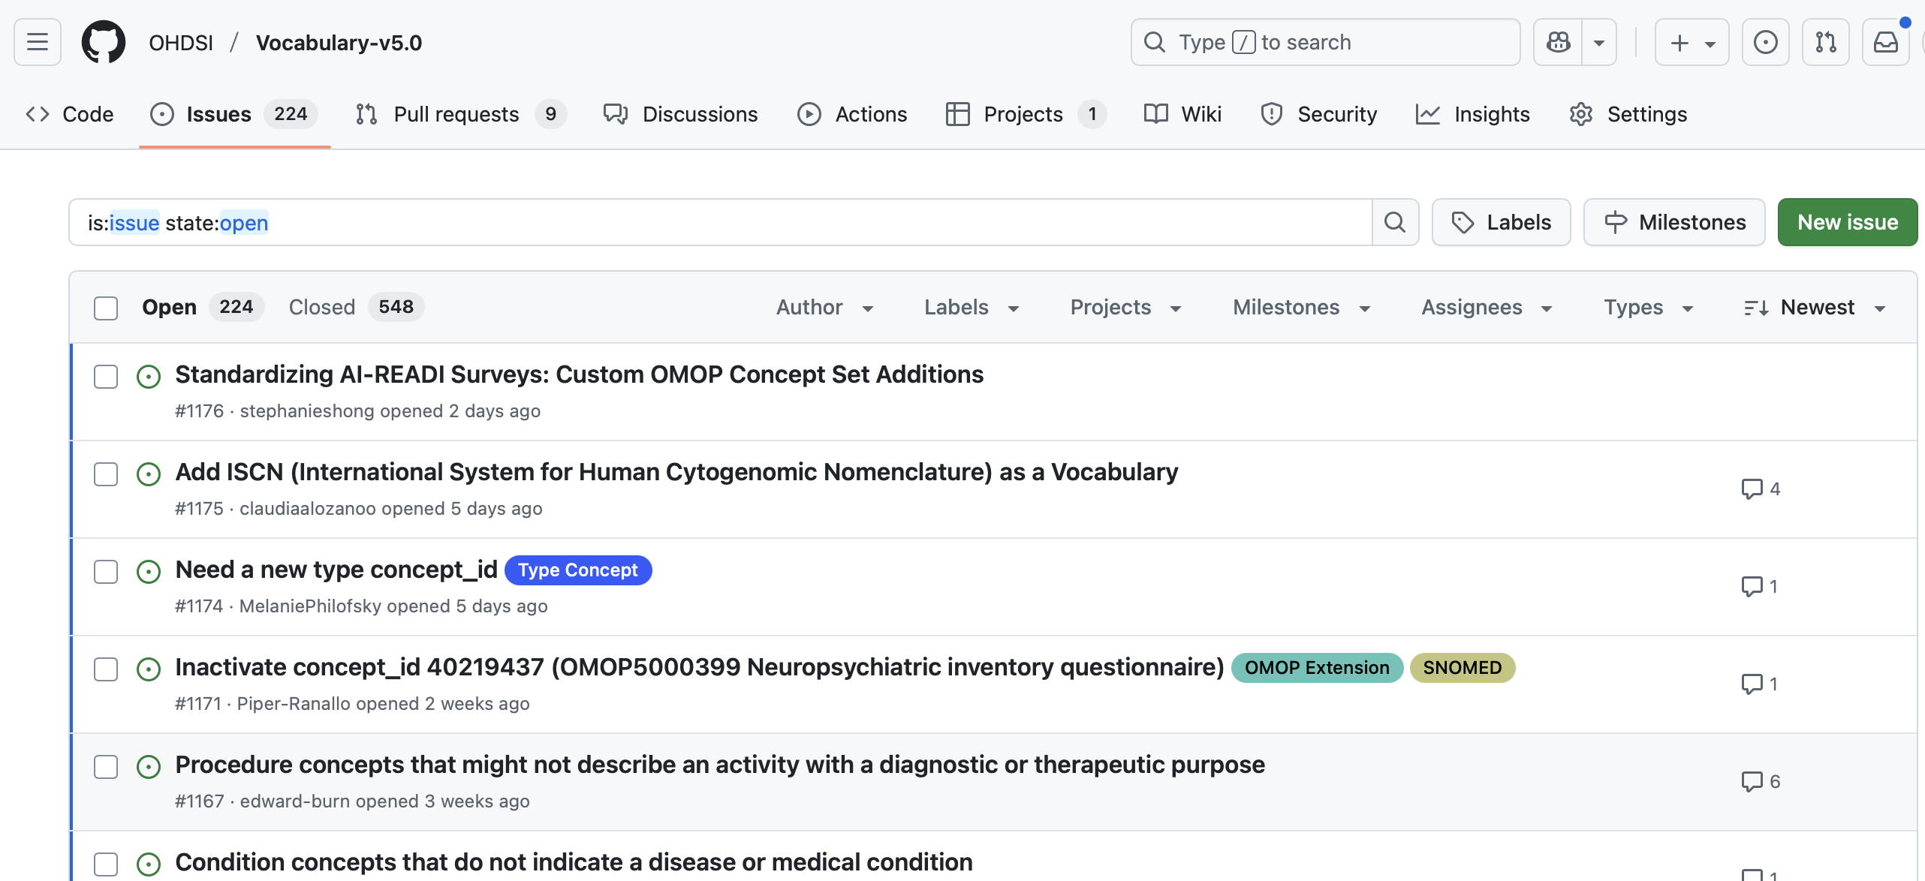
Source Codes Mapping – Scenario 3
Scenario
Solution
Source data does not map to standard vocabulary
Ask OHDSI to add the vocabulary
Utilize the community contribution process

Slide 27
OMOP CDM

Slide 28
OMOP CDM Principles
Patient centric
Vocabulary and Data Model are standardized
Domain-oriented concepts
Accommodates data from various sources
Preserves data provenance & source data
Extendable & Evolving
Database Platform Independent

Slide 29
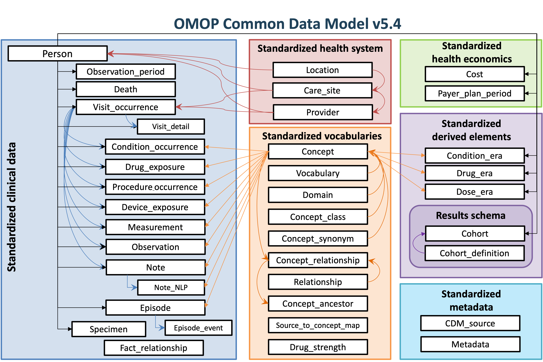
CDM Version 5.4 Key Domains

Slide 30
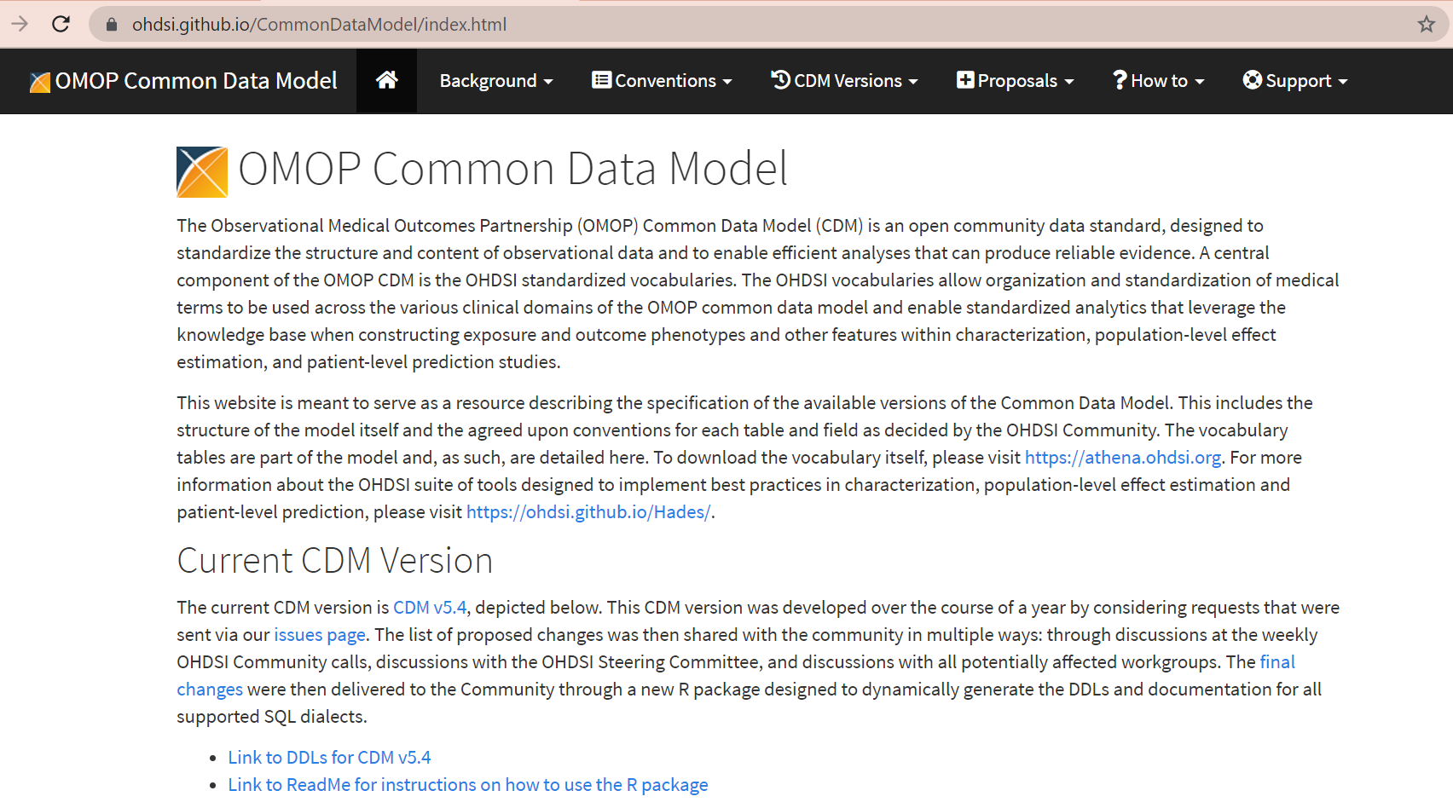

Slide 31
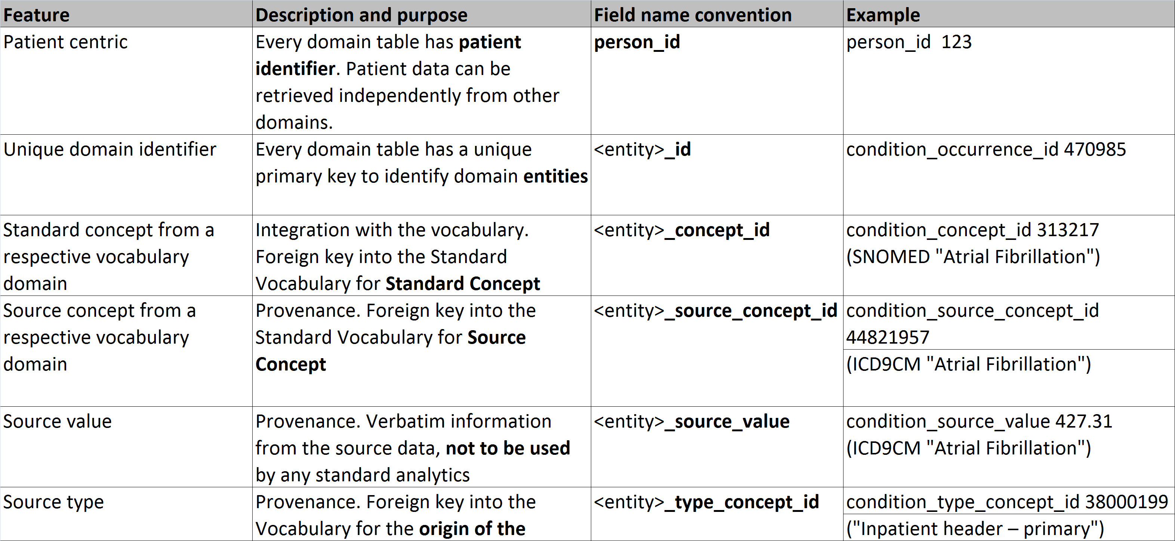
OMOP CDM Standard Domain Features

Slide 32
Clinical Case Example
A 51-year-old (DOB: 1/2/1965), African American, non-Hispanic, male patient named John Doe visited the ED on 3/1/2024 at 3:12 a.m. with groin and abdominal pain.
During the ED visit, it was determined that the patient had a kidney stone. Patient received metoclopramide 10 mg IV and morphine 6 mg IV at the ED.
Subsequently, the patient had an outpatient office visit with a urologist on 3/31/2024with a primary diagnosis of calculus of ureter (ICD9:592.1).
Following this visit, the patient had a lithotripsy preformed on 4/5/2024 with an ICD9 diagnosis code of 592.1 and procedure code of 98.51.

Slide 33
Examples
Person
person_id | 1
gender_concept_id | 8507
year_of_birth | 1965
month_of_birth | 1
day_of_birth | 1
birth_datetime | 1965-01-02T00:00:00-05:00
race_concept_id | 38003599
ethnicity_concept_id | 38003564
location_id | NULL
provider_id | NULL
care_site_id | NULL
person_source_value | NULL
gender_source_value | M:Male
gender_source_concept_id | NULL
race_source_value | A:African American
race_source_concept_id | NULL
ethnicity_source_value | NH:Non-Hispanic
ethnicity_source_concept_id | NULL
Visit Occurrence
visit_occurrence_id | 10
person_id | 1
visit_concept_id | 9203 (Emergency Room Visit)
visit_start_date | 2016-03-01
visit_start_datetime | 2024-03-01T03:12:00
visit_end_date | 2024-03-01
visit_end_datetime | 2024-03-01T10:00:00
visit_type_concept_id | 32817 (EHR record)
provider_id | NULL
care_site_id | 1
visit_source_value | E
visit_source_concept_id | NULL
admitted_from_concept_id | NULL
admitted_from_source_value | NULL
discharge_to_concept_id | NULL
discharge_to_source_value | NULL
preceding_visit_occurrence_id | NULL

Slide 34
CONDITION_OCCURRENCE
Condition Occurrence
condition_occurrence_id | 100
person_id | 1
condition_concept_id | 201916 (Kidney Stone)
condition_start_date | 2024-03-01
condition_start_datetime | 2024-03-01T03:12:00
condition_end_date | NULL
condition_end_datetime | NULL
condition_type_concept_id | 32817 (EHR)
stop_reason | NULL
provider_id | NULL
visit_occurrence_id | 10
visit_detail_id | NULL
condition_source_value | 592.1 (Kidney Stone)
condition_source_concept_id | 44825543 (ICD OMOP)
condition_status_source_value | NULL
condition_status_concept_id | NULL
Vocabulary: SNOMED -> classification
Data sources:
Billing diagnosis (inpatient, outpatient)
Problem list
Individual records <> distinct episodes

Slide 35
PROCEDURE_OCCURRENCE
Procedure Occurrence
procedure_occurrence_id | 300
person_id | 1
procedure_concept_id | 2001503 (Lithotripsy)
procedure_date | 2016-04-05
procedure_datetime | 2016-04-05T09:00:00
procedure_end_date | NULL
procedure_end_datetime | NULL
procedure_type_concept_id | 38000275 (EHR procedure record)
modifier_concept_id | NULL
quantity | 1
provider_id | NULL
visit_occurrence_id | 12
visit_detail_id | NULL
procedure_source_value | ICD9:98.51
procedure_source_concept_id | NULL
modifier_source_value | NULL
record_source_value | NULL
Vocabularies: CPT-4, HCPCS, ICD-9 Procedures, ICD-10 Procedures, LOINC, SNOMED
Procedures have the least standardized vocabularies that causes some redundancy

Slide 36
DRUG_EXPOSURE
Drug Exposure
drug_exposure_id | 200
person_id | 1
drug_concept_id | 1308216 (Metoclopramide 10 mg Inj)
drug_exposure_start_date | 2024-03-01
drug_exposure_start_datetime | 2024-03-01T03:30:00
drug_exposure_end_date | 2024-03-01
drug_exposure_end_datetime | 2024-03-01T03:45:00
verbatim_end_date | NULL
drug_type_concept_id | 32818 (EHR administration)
stop_reason | NULL
refills | NULL
quantity | 1
days_supply | 1
sig | IV push
route_concept_id | NULL
lot_number | NULL
provider_id | NULL
visit_occurrence_id | 10
visit_detail_id | NULL
drug_source_value | Metoclopramide 10 mg IV
drug_source_concept_id | NULL
route_source_value | IV
dose_unit_source_value | mg
record_source_value | NULL
Vocabulary: RxNorm-> classifications by drug class and indication
Data sources:
Pharmacy dispensing
Prescriptions written
Medication history
Source fields may vary, but so inference of drug exposure end may vary

Slide 37
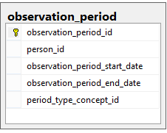
OBSERVATION_PERIOD
Spans of time where data source has capture of data
Required to run analytical methods
One person may have multiple periods if there is interruption in data capture
Challenge: determine observation periods based on the source data

Slide 38
Two OMOP designs that might be confusing
OMOP tables combine data from multiple source tables
Ordered drugs, procedure drugs, vaccines are all in Drug Exposure
Duplicates removed
Source data may be distributed over multiple OMOP tables
Not all ICD10CM billing codes are in OMOP Condition Occurrence
Notes:
Update wording and make more clear

Slide 39

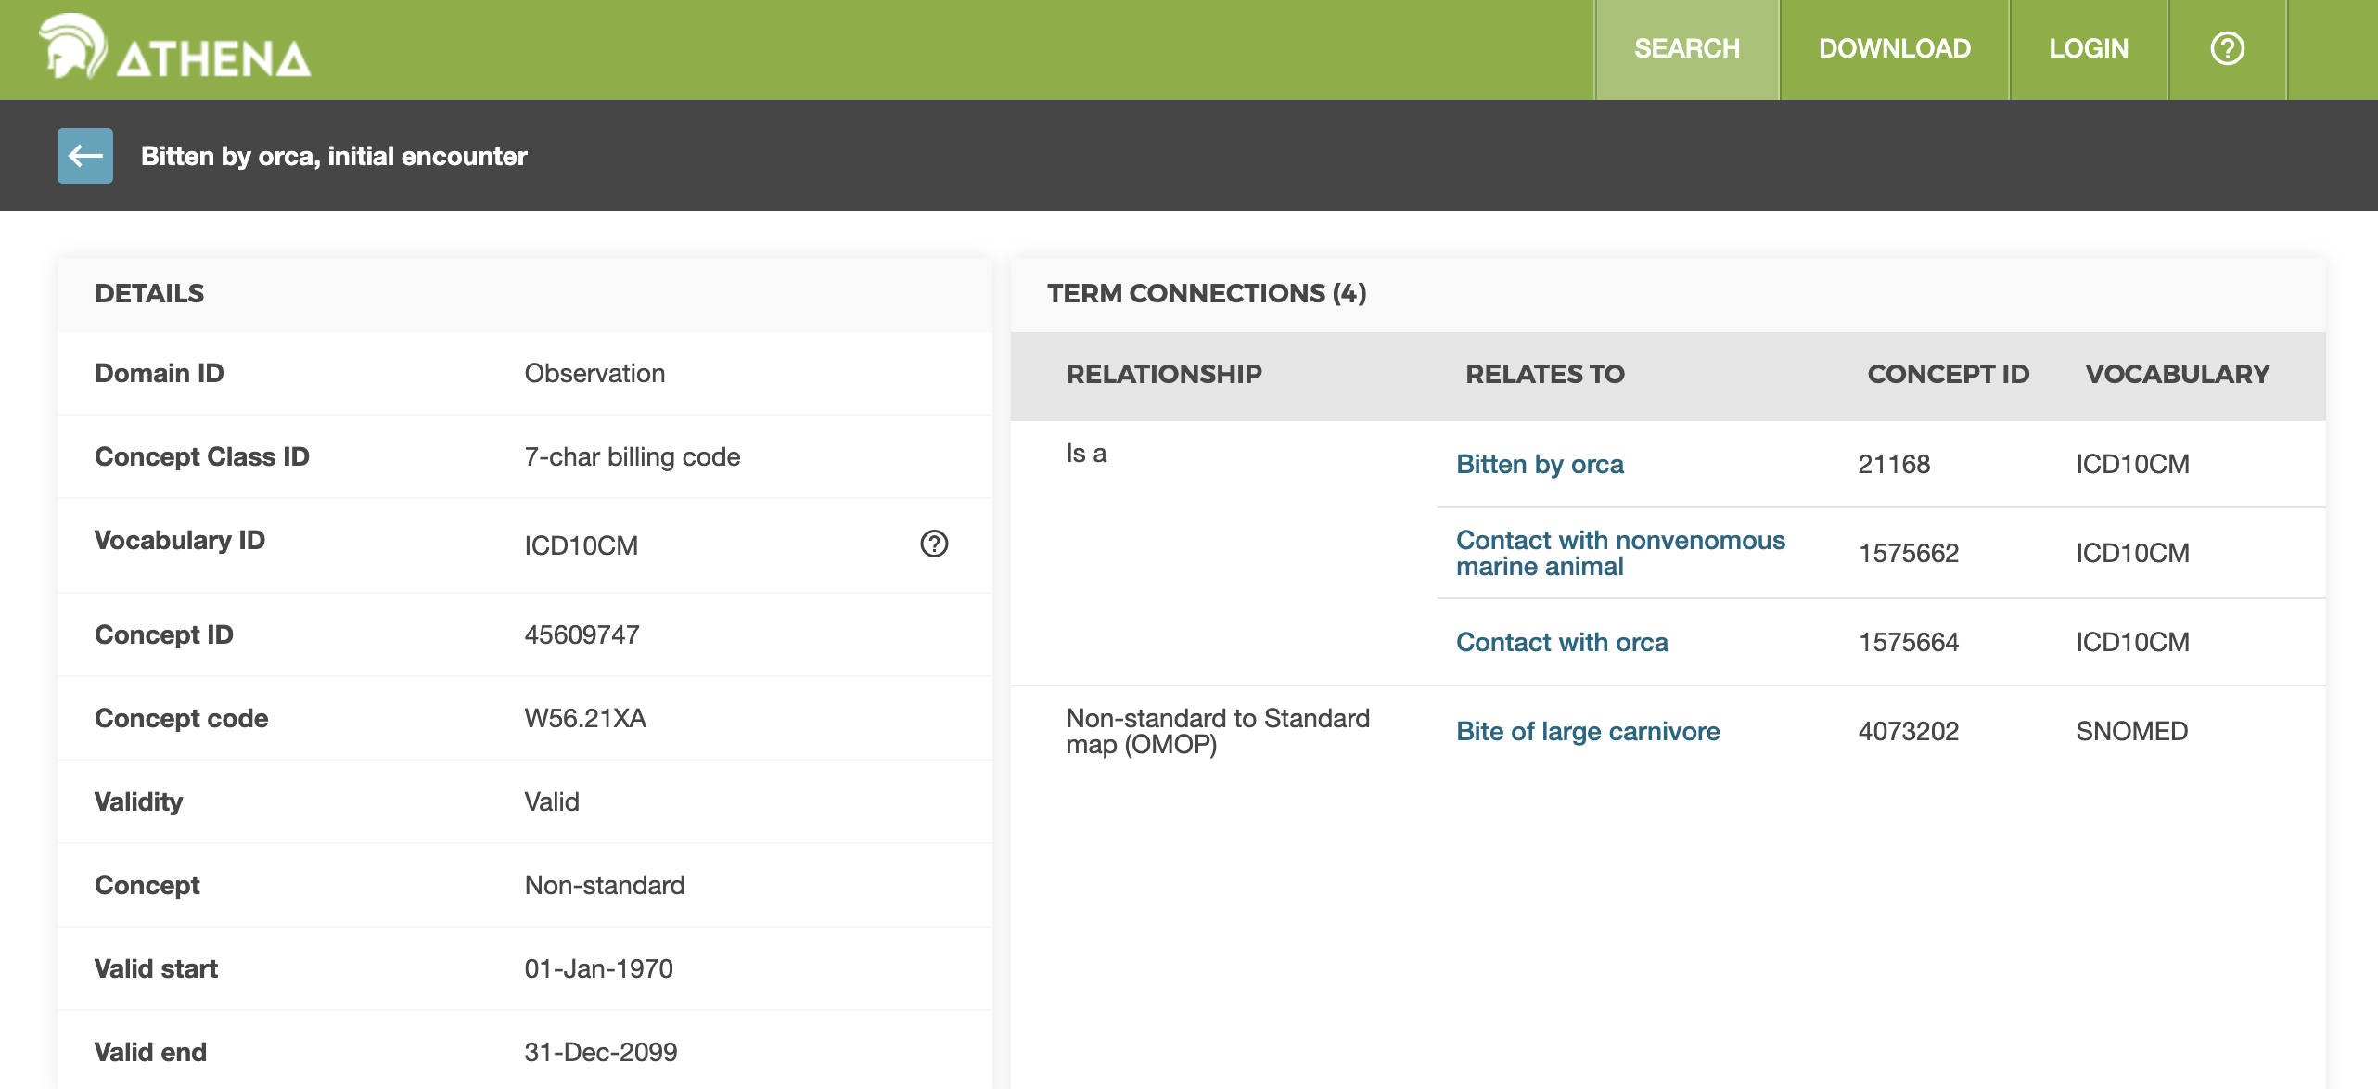
W56.21XA
Bitten by orca, initial encounter
(Observation)
Notes:
they are about 8.5 feet long and 265 to 353 lbs. at birth. Orcas can hold their breath for up to 15 minutes

Slide 40
General CDM rules & requirements *found on ohdsi.github.io/CommonDataModel/index.html
3 required tables
Person, Observation_Period and CDM Source
Required fields vary by table
_ids, _date, _concept_id, _type_concept_id fields generally required
Populate source values
Critical in understanding provenance

Slide 41
OMOP CDM Related Working Groups

Slide 42
Themis: What is it?
The goal of Themis is to provide conventions on how source data should be standardized to the OMOP CDM to support the OHDSI community to generate the evidence that promotes better health decisions and better care. When there is ambiguity on how data should be inserted into the CDM, Themis will examine the issue, create a convention and document it.
We follow the FAIR principles: Findable, Accessible, Interoperable and Reusable.
Themis makes decisions for the good of the whole community. We must compromise. We can always revisit and modify the convention. Don’t let perfect be the enemy of great. And interoperability between different OMOP CDMs is great!

Slide 43
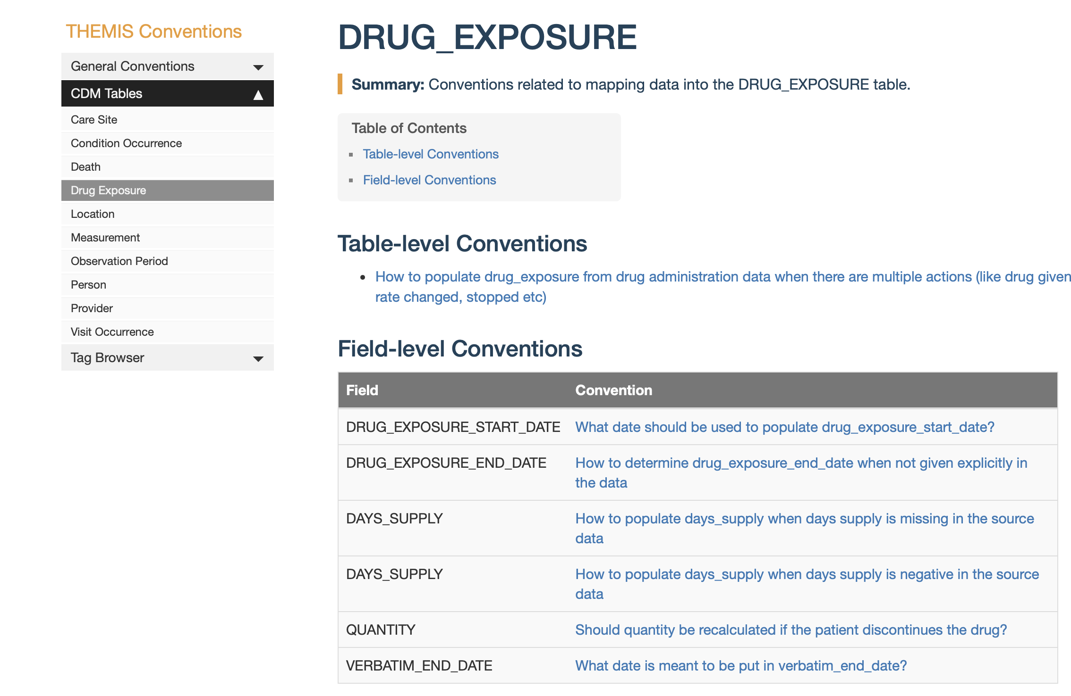
Themis convention library

Slide 44
THEMIS
What do I do when there’s ambiguity on how/where I should insert data into the OMOP CDM?
Themis WG meets twice a month on the 1st & 3rd Thursday of the month
Themis convention library houses all conventions
https://ohdsi.github.io/Themis/index.html
Themis GitHub contains issues, project plan and Themis process
https://github.com/OHDSI/Themis
Please contact Melanie Philofsky (Philofsky@ohdsi.org) for more information

Slide 45
CDM Working Group
Working group meets once a month to discuss proposed changes to the CDM
All CDM documentation, versions, and proposals located on GitHub
https://ohdsi.github.io/CommonDataModel/index.html
Proposals tracked and discussed as GitHub issues
https://ohdsi.github.io/TheBookOfOhdsi/CommonDataModel.html
Meeting information can be found on the working group wiki page
Please contact Clair Blacketer (mblacke@its.jnj.com) for more information

Slide 46
Other Work Groups
Vocabulary
Health Systems
Download vocabulary tables from Athena
https://athena.ohdsi.org/search-terms/terms
Submit concerns on the Github
https://github.com/OHDSI/Vocabulary-v5.0
General information
https://github.com/OHDSI/Vocabulary-v5.0/wiki
Support health systems on their OHDSI journey
Meet every other Monday at 10am Eastern Time on MS Teams
Healthcare Systems Interest Group | General | Microsoft Teams

Slide 47
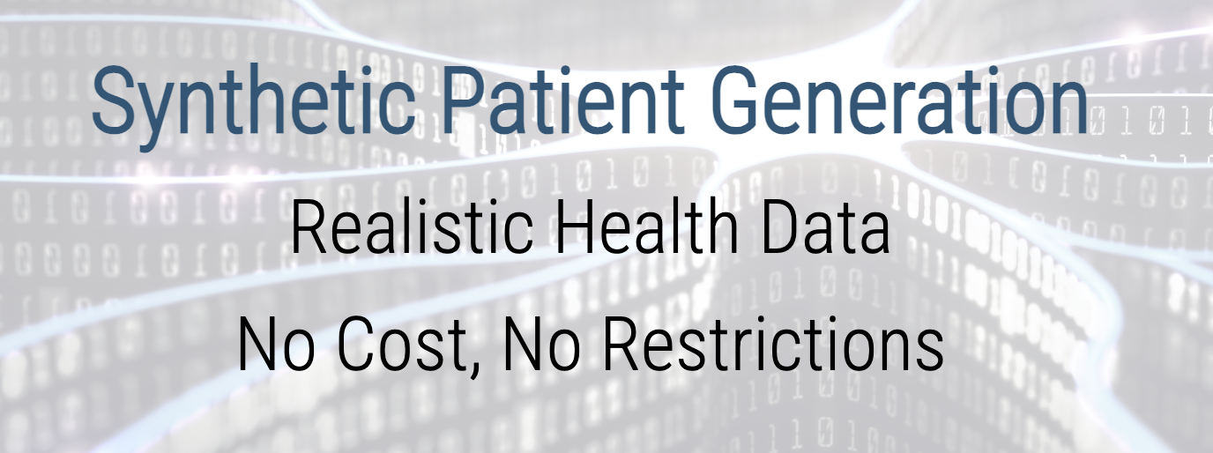

SyntheaTM Synthetic Patient Generator

Slide 48
What is Synthea?
SyntheaTM is a Synthetic Patient Population Simulator.
Produces realistic (but not real), patient data
Available in variety of output formats: CSV, HL7 FHIR, C-CDA, CPCDS
Free
https://github.com/synthetichealth/synthea
Walonoski J, Kramer M, Nichols J, Quina A, Moesel C, Hall D, Duffett C, Dube K, Gallagher T, McLachlan S. Synthea: An approach, method, and software mechanism for generating synthetic patients and the synthetic electronic health care record. J Am Med Inform Assoc. 2017 Aug 30. doi: 10.1093/jamia/ocx079. [Epub ahead of print] PubMed PMID: 29025144.

Slide 49
Key Features
Mimics Medical History: Birth to Death
Configurable Populations
size, demographics, location, observation time/years of history
Disease & Intervention Modules (e.g. diabetes, asthma, cancer)
Additional Modules: https://github.com/synthetichealth/synthea/tree/gh-pages/graphviz
Open Source: You can contribute too!

Slide 50
Key Features
No PII/ HIPAA Compliant
Supports many use cases
ETL Development
Scalability/ Stress Testing
Data Quality Validation
Tutorials!

Slide 51
Example Data Elements
Demographics (age, sex, race, ethnicity, address)
Social Determinants of Health (County level)
Encounters
Conditions & Diagnoses
Medications & Immunizations
Lab Results & Vital Signs
Procedures

Slide 52
Synthea Tables – CSV Export
File | Description
allergies.csv | Patient allergy data.
careplans.csv | Patient care plan data, including goals.
claims.csv | Patient claim data.
claims_transactions.csv | Transactions per line item per claim
conditions.csv | Patient conditions or diagnoses.
devices.csv | Patient-affixed permanent and semi-permanent devices.
encounters.csv | Patient encounter data.
imaging_studies.csv | Patient imaging metadata.
immunizations.csv | Patient immunization data.
medications.csv | Patient medication data.
observations.csv | Patient observations including vital signs and lab reports.
organizations.csv | Provider organizations including hospitals.
patients.csv | Patient demographic data.
payer_transitions.csv | Payer Transition data (i.e. changes in health insurance).
payers.csv | Payer organization data.
procedures.csv | Patient procedure data including surgeries.
providers.csv | Clinicians that provide patient care.
supplies.csv | Supplies used in the provision of care.
Notes:
Should have gotten an email with links to these csv files, we’re going to be using them today so if you’d like to follow along download them.

Slide 53
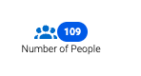
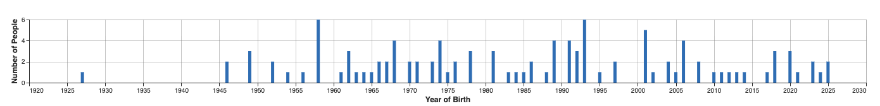
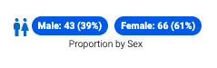
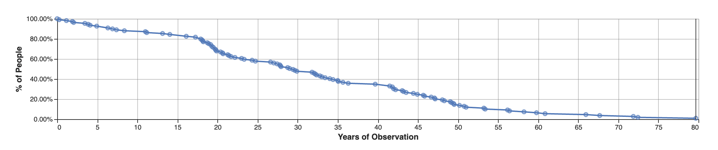
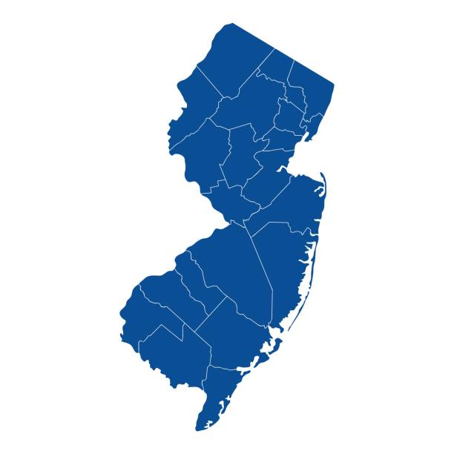
Our population
Year of Birth
Years of Observation
New Jersey
53

Slide 54
Our Population
Top 10 Conditions
Gingivitis | 85.32 %
Viral sinusitis | 81.65 %
Dental caries | 62.38 %
Acute viral pharyngitis | 60.55 %
Acute bronchitis | 55.96 %
Normal pregnancy | 39.45 %
Essential Hypertension | 36.70 %
Anemia | 32.11 %
Prediabetes | 32.11 %
Acute infective cystitis | 24.77 %
Top 10 Procedures
Medical Reconciliation | 99.08 %
Assessment of substance abuse | 83.49 %
Assessment of anxiety | 82.57 %
Assessment of health and social care needs | 80.73 %
Physical examination | 39.45 %
Initial patient assessment | 37.62 %
Ultrasound scan for fetal viability | 37.62 %
Development of individualized plan of care | 37.62 %
Detection of anomaly | 36.70 %
Auscultation of fetal heart | 36.70 %
Notes:
Population 66% females, could explain why we are seeing conditions like normal pregnancy in the top 10 conditions.
Additionally, we can see corresponding procedures that we could associate with that condition.
Synthea does well with modeling patient care.

Slide 55
Our Population
Top 10 Conditions
Gingivitis | 85.32 %
Viral sinusitis | 81.65 %
Dental caries | 62.38 %
Acute viral pharyngitis | 60.55 %
Acute bronchitis | 55.96 %
Normal pregnancy | 39.45 %
Essential Hypertension | 36.70 %
Anemia | 32.11 %
Prediabetes | 32.11 %
Acute infective cystitis | 24.77 %
Top 10 Procedures
Medical Reconciliation | 99.08 %
Assessment of substance abuse | 83.49 %
Assessment of anxiety | 82.57 %
Assessment of health and social care needs | 80.73 %
Physical examination | 39.45 %
Initial patient assessment | 37.62 %
Ultrasound scan for fetal viability | 37.62 %
Development of individualized plan of care | 37.62 %
Detection of anomaly | 36.70 %
Auscultation of fetal heart | 36.70 %
Notes:
Population 66% females, could explain why we are seeing conditions like normal pregnancy in the top 10 conditions.
Additionally, we can see corresponding procedures that we could associate with that condition.
Synthea does well with modeling patient care.

Slide 56
Our Population
Top 10 Drugs
Influenza Vaccine | 98.16 %
TDAP Vaccine | 72.48 %
acetaminophen | 55.05 %
MCV4P Vaccine | 39.45 %
amoxicillin | 34.86 %
Hepatitis A Vaccine | 32.11 %
HPV Vaccine | 32.11 %
Zoster Vaccine | 31.19 %
PCV 13 | 30.28 %
DTAP vaccine | 29.36 %
Top 10 Measurements
Platelets | 100 %
Hemoglobin | 100 %
Erythrocytes | 100 %
Diastolic Blood Pressure | 100 %
Heart Rate | 100 %
Body Height | 100 %
Systolic Blood Pressure | 100 %
Pain severity score | 100 %
Body Weight | 100 %
MCV | 100%
Notes:
Perhaps there are things we don’t quite expect. Our public health friends might be happy with 98% of persons getting an influenza vaccine. But do we really expect 100% of patients to have these lab values measured?

Slide 57
Our Population
Top 10 Drugs
Influenza Vaccine | 98.16 %
TDAP Vaccine | 72.48 %
acetaminophen | 55.05 %
MCV4P Vaccine | 39.45 %
amoxicillin | 34.86 %
Hepatitis A Vaccine | 32.11 %
HPV Vaccine | 32.11 %
Zoster Vaccine | 31.19 %
PCV 13 | 30.28 %
DTAP vaccine | 29.36 %
Top 10 Measurements
Platelets | 100 %
Hemoglobin | 100 %
Erythrocytes | 100 %
Diastolic Blood Pressure | 100 %
Heart Rate | 100 %
Body Height | 100 %
Systolic Blood Pressure | 100 %
Pain severity score | 100 %
Body Weight | 100 %
MCV | 100%
Notes:
Perhaps there are things we don’t quite expect. Our public health friends might be happy with 98% of persons getting an influenza vaccine. But do we really expect 100% of patients to have these lab values measured?

Slide 58
ETL Process and Logic
Notes:
Now we are all experts on the CDM, vocabulary and now data. We can start to talk about the ETL process.

Slide 59









ETL Process
ETL Documentation
ETL
Data experts and CDM experts together design the ETL
People with medical knowledge create the code mappings
All are involved in quality control
A technical person implements the ETL
OHDSI Tools
White
Rabbit
Rabbit In a Hat
Usagi
White
Rabbit
ACHILLES
DQD
Rabbit In a Hat

Slide 60
ETL Process
ETL Documentation
ETL
Data experts and CDM experts together design the ETL
People with medical knowledge create the code mappings
We won’t be covering this today
All are involved in quality control
A technical person implements the ETL
X
OHDSI Tools
White
Rabbit
Rabbit In a Hat
Usagi
White
Rabbit
ACHILLES
DQD
Rabbit In a Hat

Slide 61

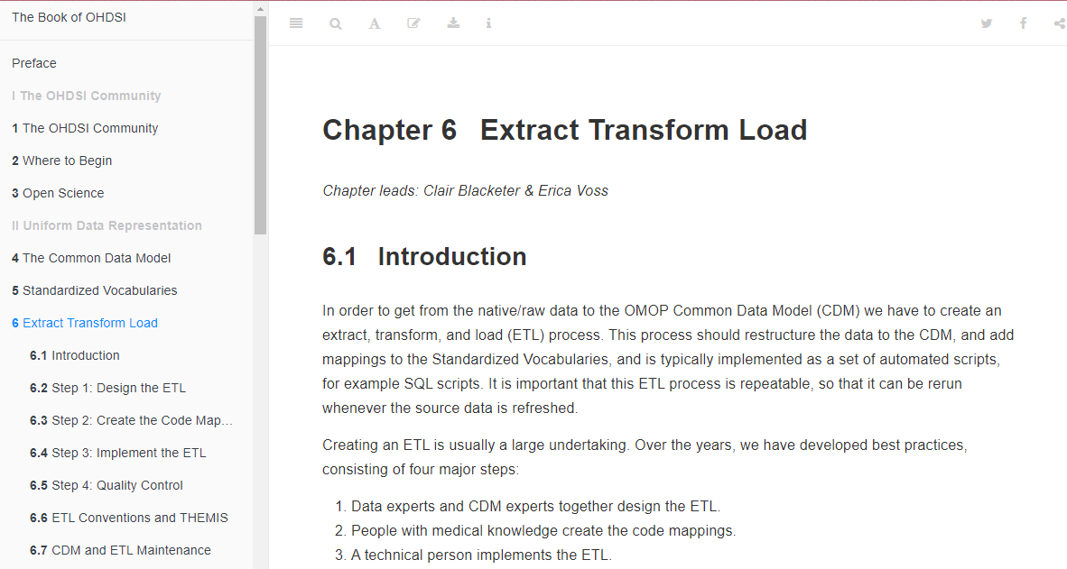
ETL Process
https://ohdsi.github.io/TheBookOfOhdsi/ExtractTransformLoad.html

Slide 62

Follow-Along Exercises for Today
Scan a database with White Rabbit
Practice building an ETL document with Rabbit in a Hat
Examining Achilles and Data Quality Dashboard output

Slide 63
Tools help us get started . . .
White Rabbit
Rabbit In a Hat
performs a scan of the source data, providing detailed information on the tables, fields, and values that appear in a field
Uses White Rabbit scan to provide a graphical user interface to help build an ETL document
Does not generate code

Slide 64
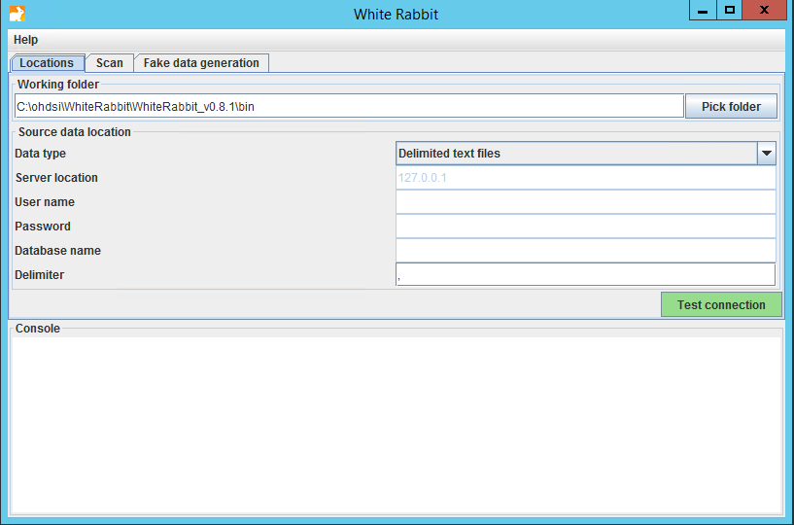
White Rabbit - Location
Notes:
https://ohdsi.github.io/WhiteRabbit/WhiteRabbit.html#Specifying_the_Location_of_Source_Data

Slide 65
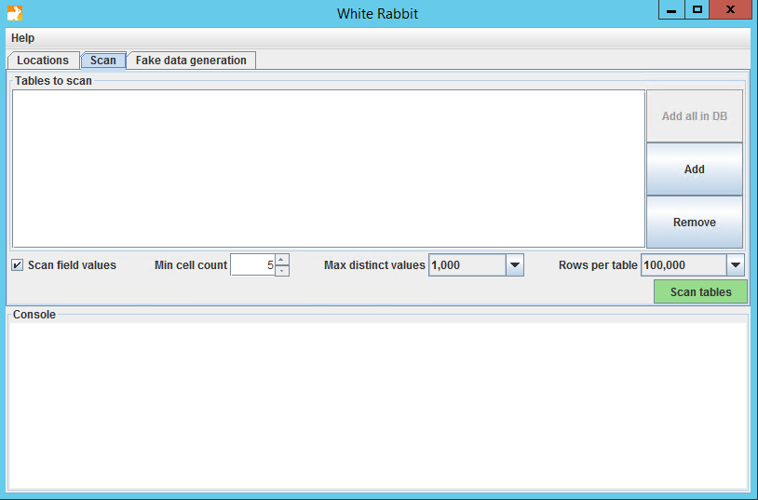
White Rabbit - Scan

Slide 66
White Rabbit - Scan

Slide 67
White Rabbit - Scan

Slide 68
White Rabbit – Scan Report
synthea
We already ran the scan on synthea native data
To open the scan while we review:
https://github.com/OHDSI/Tutorial-ETL
Materials → WhiteRabbit → Synthea_ScanReport.xlsx
Click “View Raw” to download the XLSX

Slide 69
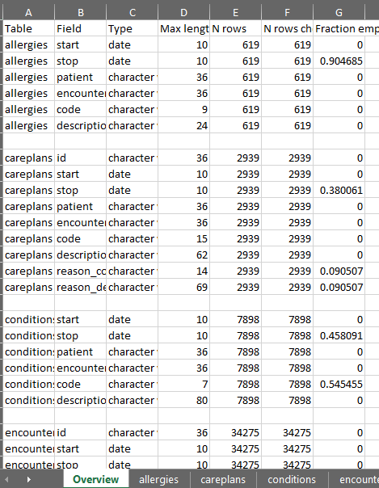
White Rabbit – Scan Report: Synthea
Overview Tab

Slide 70
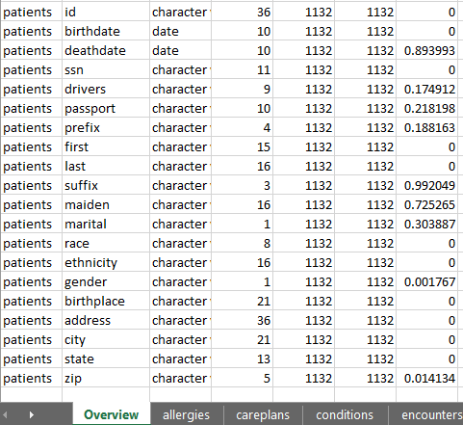
White Rabbit – Scan Report: Synthea
Overview Tab

Slide 71
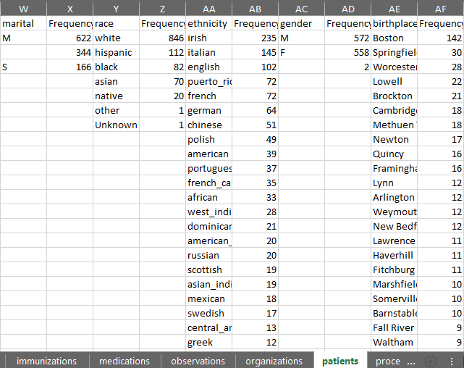
White Rabbit – Scan Report: Synthea
Patients Tab
Notes:
Ethnicity = (Hispanics and Non-Hispanics)
Race = (white, black, Asian, native, other, unknown)

Slide 72
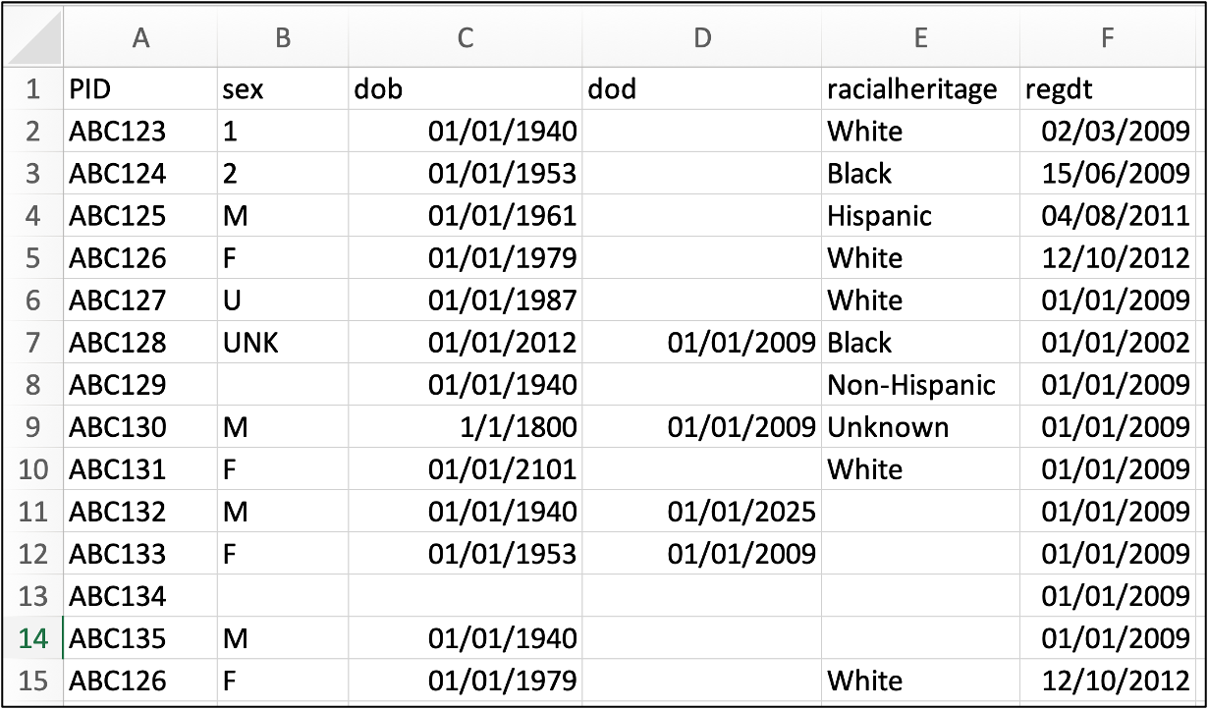
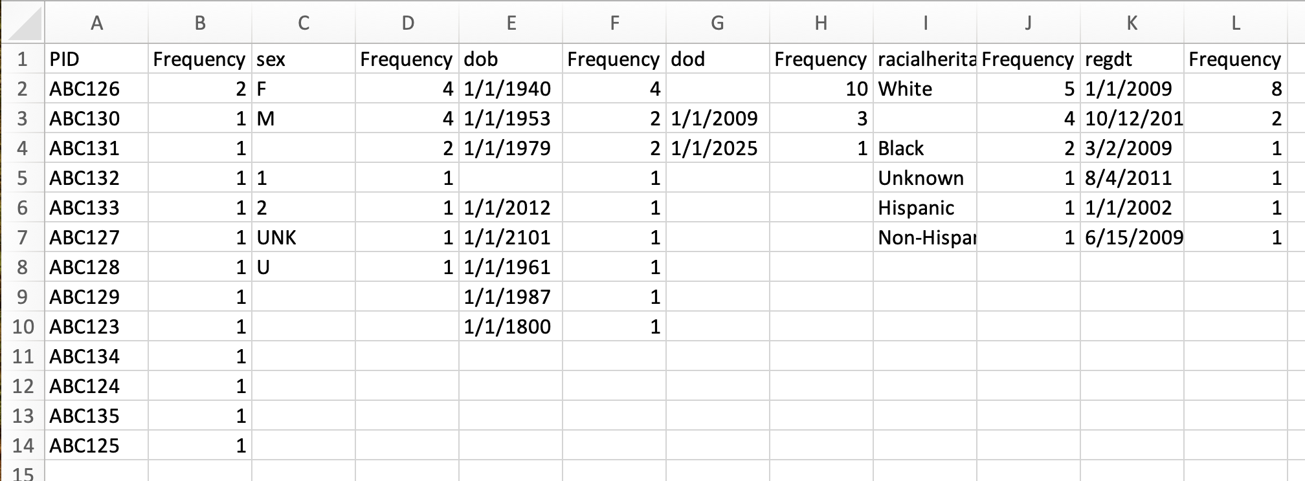
Review Scan Report
Look for
Odd values in dates
Missing genders
Missing birth years or birthdates
Missing codes
Real data can be messy!

Slide 73
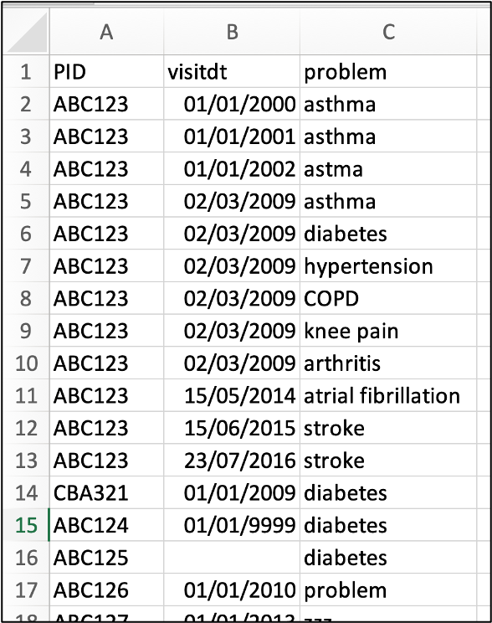
Case study example
Notes:
Synthea is really clean, here is an example of how the data actually looks in the real world

Slide 74
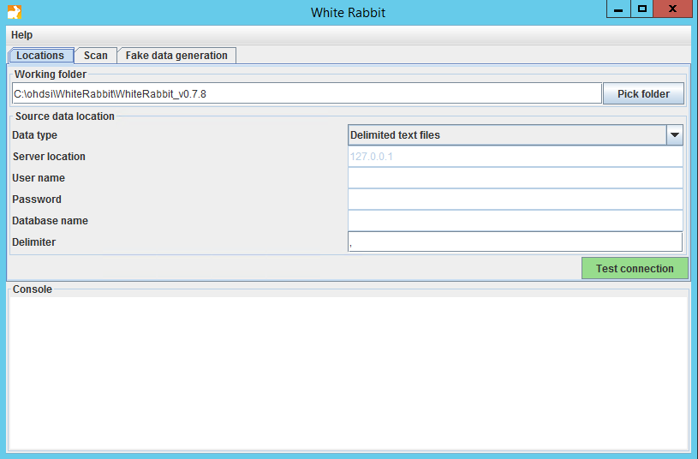
White Rabbit
White Rabbit creates an export of information about the source data
The scan can be used to:
Learn about your source data
Used by Rabbit In a Hat

Slide 75
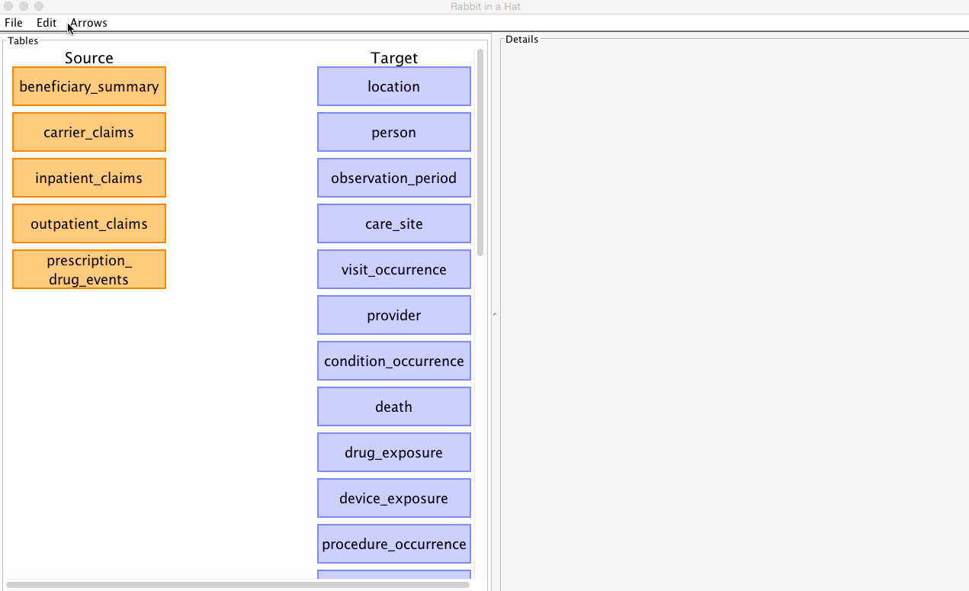
Rabbit in a Hat
Can read and display a White Rabbit scan document
Provides a graphical interface to allow a user to connect source data to tables
Notes:
CB Start

Slide 76
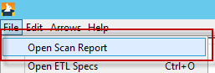
Rabbit in a Hat
Synthea
We will use the Synthea_ScanReport.xlsx for this:
https://github.com/OHDSI/Tutorial-ETL
Materials → WhiteRabbit → Synthea_ScanReport.xlsx
Press the “Download” button
Save it to the desktop
Open it Rabbit in a Hat

Slide 77
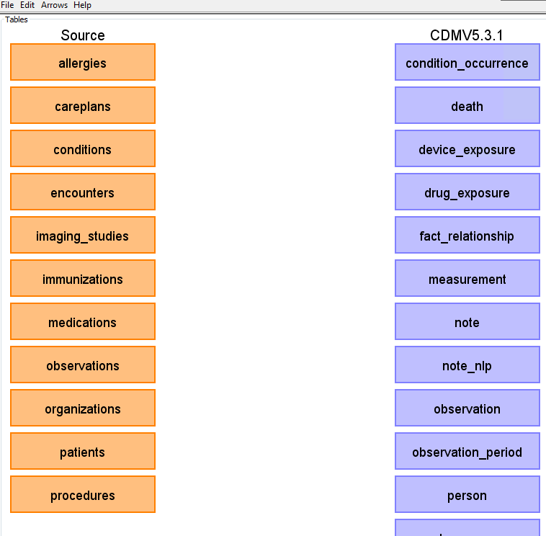
Rabbit in a Hat
The scan tells Rabbit in a Hat what is in the raw database
Orange Tables = Raw
Blue Tables = CDM

Slide 78

Rabbit in a Hat
Tables we will go through today ->
Person
Generate document
Observation_period
Visit_occurrence
Condition_occurrence
Drug_exposure
Notes:
In the condition occurrence table – we can come back to this and augment with source code mapping
Should think about how to find TYPE concepts

Slide 79

Resources
Important links to keep in mind when working on an ETL:
CDM Documentation https://ohdsi.github.io/CommonDataModel Information about the CDM structure and conventions to follow can be found here
OHDSI Forums http://forums.ohdsi.org/ http://forums.ohdsi.org/c/cdm-builders OHDSI is an active community, your questions may have already been asked on the forum however if not do not be afraid to ask it yourself!
Book of OHDSI: ETL Chapter https://ohdsi.github.io/TheBookOfOhdsi/ExtractTransformLoad.html The OHSDI community wrote the book to serve as a central knowledge repository for all things OHDSI.
THEMIS Repository https://ohdsi.github.io/Themis/

Slide 80
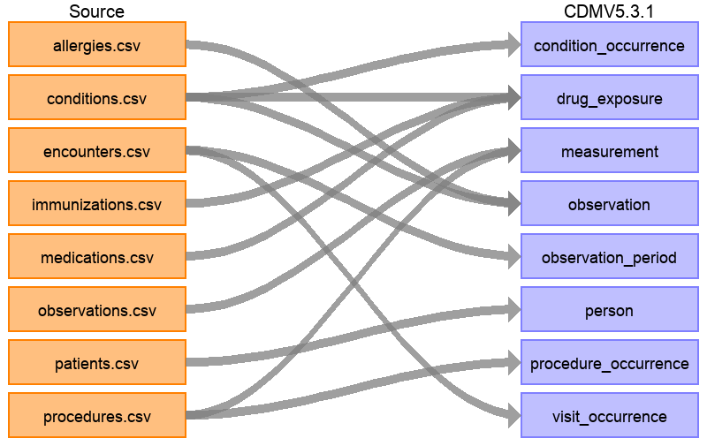
Rabbit in a Hat
The full ETL document: https://ohdsi.github.io/ETL-Synthea/
Notes:
Pull up drug exposure

Slide 81
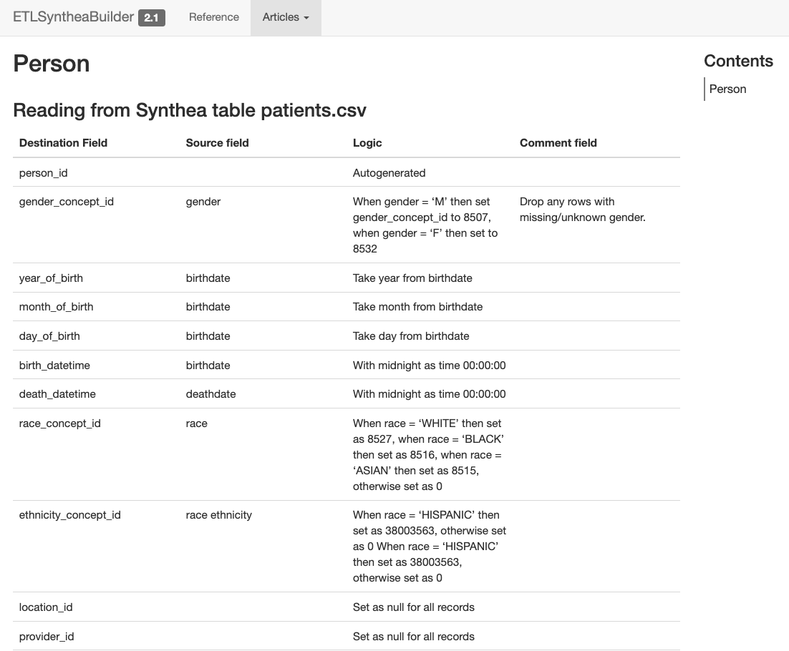
PERSON
https://ohdsi.github.io/ETL-Synthea/articles/person.html

Slide 82
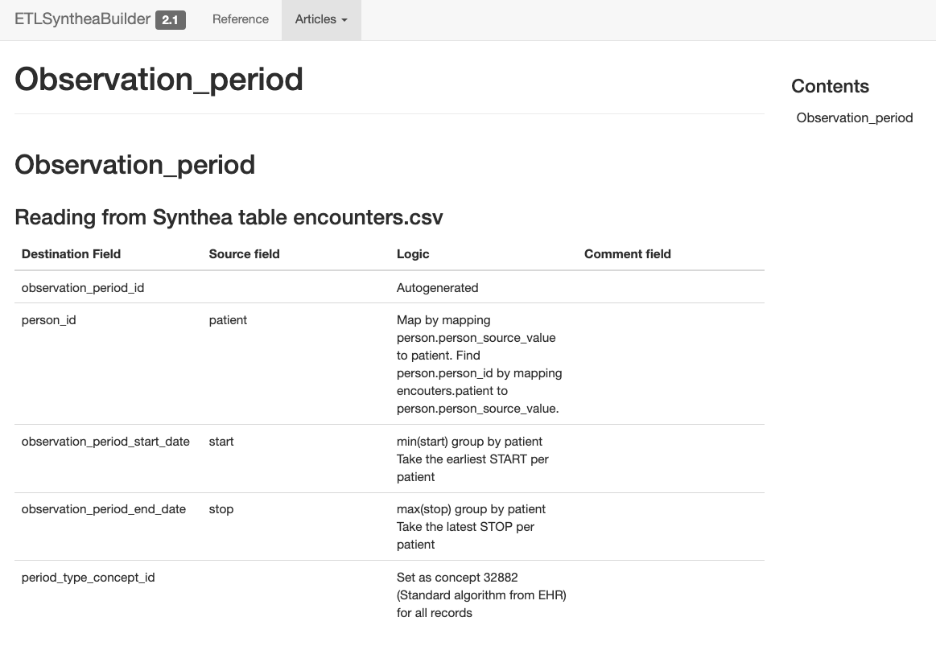
OBSERVATION_PERIOD
https://ohdsi.github.io/ETL-Synthea/articles/observation_period.html

Slide 83
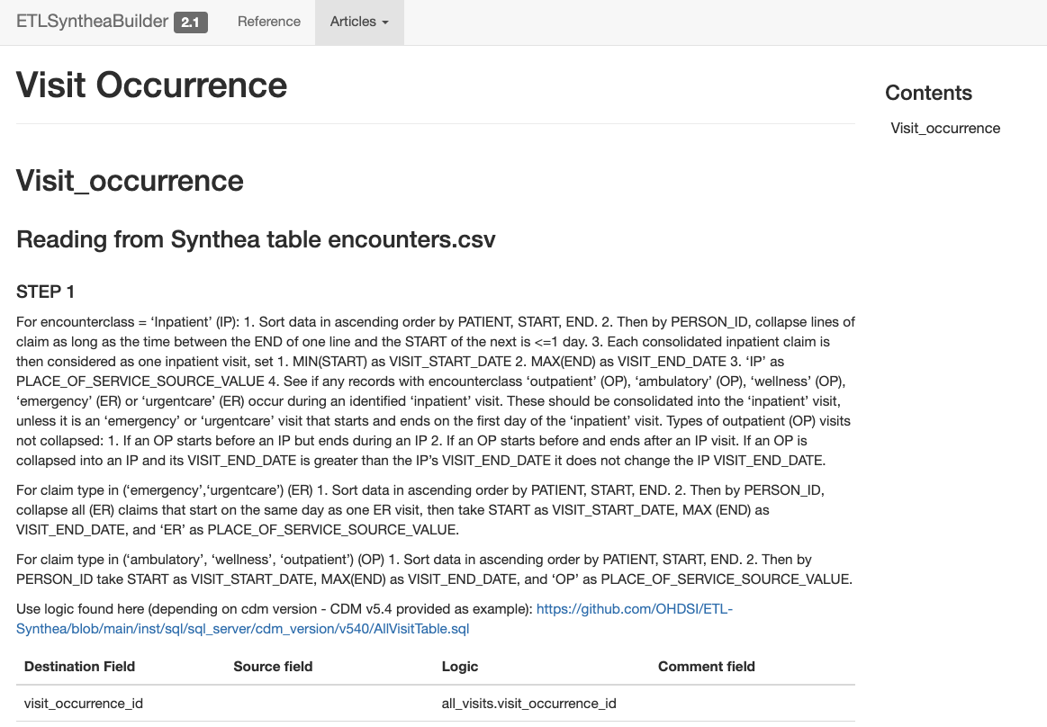
VISIT_OCCURRENCE
ETL Conventions: https://ohdsi.github.io/CommonDataModel/cdm54.html#visit_occurrence
Visit Hierarchy
IP
>
ER
>
OP

Slide 84
OMOP Vocab
There are two standard queries to help us use the OMOP Vocabulary:
SOURCE_TO_STANDARD.sql
SOURCE_TO_SOURCE.sql
https://github.com/OHDSI/Tutorial-ETL
Materials → Queries

Slide 85
Source to Standard
WITH CTE_VOCAB_MAP AS (
SELECT c.concept_code AS SOURCE_CODE, c.concept_id AS SOURCE_CONCEPT_ID, c.concept_name AS SOURCE_CODE_DESCRIPTION,
c.vocabulary_id AS SOURCE_VOCABULARY_ID, c.domain_id AS SOURCE_DOMAIN_ID, c.CONCEPT_CLASS_ID AS SOURCE_CONCEPT_CLASS_ID,
c.VALID_START_DATE AS SOURCE_VALID_START_DATE, c.VALID_END_DATE AS SOURCE_VALID_END_DATE, c.INVALID_REASON AS SOURCE_INVALID_REASON, c1.concept_id AS TARGET_CONCEPT_ID, c1.concept_name AS TARGET_CONCEPT_NAME, c1.VOCABULARY_ID AS TARGET_VOCABUALRY_ID,
c1.domain_id AS TARGET_DOMAIN_ID, c1.concept_class_id AS TARGET_CONCEPT_CLASS_ID, c1.INVALID_REASON AS TARGET_INVALID_REASON, c1.standard_concept AS TARGET_STANDARD_CONCEPT
FROM CONCEPT C
JOIN CONCEPT_RELATIONSHIP CR
ON C.CONCEPT_ID = CR.CONCEPT_ID_1
AND CR.invalid_reason IS NULL
AND cr.relationship_id = 'Maps to'
JOIN CONCEPT C1
ON CR.CONCEPT_ID_2 = C1.CONCEPT_ID
AND C1.INVALID_REASON IS NULL
UNION
SELECT source_code, SOURCE_CONCEPT_ID, SOURCE_CODE_DESCRIPTION, source_vocabulary_id, c1.domain_id AS SOURCE_DOMAIN_ID, c2.CONCEPT_CLASS_ID AS SOURCE_CONCEPT_CLASS_ID,c1.VALID_START_DATE AS SOURCE_VALID_START_DATE,
c1.VALID_END_DATE AS SOURCE_VALID_END_DATE, stcm.INVALID_REASON AS SOURCE_INVALID_REASON,target_concept_id,
c2.CONCEPT_NAME AS TARGET_CONCEPT_NAME, target_vocabulary_id, c2.domain_id AS TARGET_DOMAIN_ID,
c2.concept_class_id AS TARGET_CONCEPT_CLASS_ID, c2.INVALID_REASON AS TARGET_INVALID_REASON,
c2.standard_concept AS TARGET_STANDARD_CONCEPT
FROM source_to_concept_map stcm
LEFT OUTER JOIN CONCEPT c1
ON c1.concept_id = stcm.source_concept_id
LEFT OUTER JOIN CONCEPT c2
ON c2.CONCEPT_ID = stcm.target_concept_id
WHERE stcm.INVALID_REASON IS NULL
)
SELECT TARGET_CONCEPT_ID, TARGET_CONCEPT_NAME, TARGET_DOMAIN_ID
FROM CTE_VOCAB_MAP
WHERE SOURCE_CODE = 'N94.6'
AND SOURCE_VOCABULARY_ID = 'ICD10CM'
AND TARGET_STANDARD_CONCEPT = 'S'

Slide 86
Source to Standard
WITH CTE_VOCAB_MAP AS (
SELECT c.concept_code AS SOURCE_CODE, c.concept_id AS SOURCE_CONCEPT_ID, c.concept_name AS SOURCE_CODE_DESCRIPTION,
c.vocabulary_id AS SOURCE_VOCABULARY_ID, c.domain_id AS SOURCE_DOMAIN_ID, c.CONCEPT_CLASS_ID AS SOURCE_CONCEPT_CLASS_ID,
c.VALID_START_DATE AS SOURCE_VALID_START_DATE, c.VALID_END_DATE AS SOURCE_VALID_END_DATE, c.INVALID_REASON AS SOURCE_INVALID_REASON, c1.concept_id AS TARGET_CONCEPT_ID, c1.concept_name AS TARGET_CONCEPT_NAME, c1.VOCABULARY_ID AS TARGET_VOCABUALRY_ID,
c1.domain_id AS TARGET_DOMAIN_ID, c1.concept_class_id AS TARGET_CONCEPT_CLASS_ID, c1.INVALID_REASON AS TARGET_INVALID_REASON, c1.standard_concept AS TARGET_STANDARD_CONCEPT
FROM CONCEPT C
JOIN CONCEPT_RELATIONSHIP CR
ON C.CONCEPT_ID = CR.CONCEPT_ID_1
AND CR.invalid_reason IS NULL
AND cr.relationship_id = 'Maps to'
JOIN CONCEPT C1
ON CR.CONCEPT_ID_2 = C1.CONCEPT_ID
AND C1.INVALID_REASON IS NULL
UNION
SELECT source_code, SOURCE_CONCEPT_ID, SOURCE_CODE_DESCRIPTION, source_vocabulary_id, c1.domain_id AS SOURCE_DOMAIN_ID, c2.CONCEPT_CLASS_ID AS SOURCE_CONCEPT_CLASS_ID,c1.VALID_START_DATE AS SOURCE_VALID_START_DATE,
c1.VALID_END_DATE AS SOURCE_VALID_END_DATE, stcm.INVALID_REASON AS SOURCE_INVALID_REASON,target_concept_id,
c2.CONCEPT_NAME AS TARGET_CONCEPT_NAME, target_vocabulary_id, c2.domain_id AS TARGET_DOMAIN_ID,
c2.concept_class_id AS TARGET_CONCEPT_CLASS_ID, c2.INVALID_REASON AS TARGET_INVALID_REASON,
c2.standard_concept AS TARGET_STANDARD_CONCEPT
FROM source_to_concept_map stcm
LEFT OUTER JOIN CONCEPT c1
ON c1.concept_id = stcm.source_concept_id
LEFT OUTER JOIN CONCEPT c2
ON c2.CONCEPT_ID = stcm.target_concept_id
WHERE stcm.INVALID_REASON IS NULL
)
SELECT TARGET_CONCEPT_ID, TARGET_CONCEPT_NAME, TARGET_DOMAIN_ID
FROM CTE_VOCAB_MAP
WHERE SOURCE_CODE = 'N94.6'
AND SOURCE_VOCABULARY_ID = 'ICD10CM'
AND TARGET_STANDARD_CONCEPT = 'S'
Look in the OMOP Vocabulary for a map

Slide 87
Source to Standard
WITH CTE_VOCAB_MAP AS (
SELECT c.concept_code AS SOURCE_CODE, c.concept_id AS SOURCE_CONCEPT_ID, c.concept_name AS SOURCE_CODE_DESCRIPTION,
c.vocabulary_id AS SOURCE_VOCABULARY_ID, c.domain_id AS SOURCE_DOMAIN_ID, c.CONCEPT_CLASS_ID AS SOURCE_CONCEPT_CLASS_ID,
c.VALID_START_DATE AS SOURCE_VALID_START_DATE, c.VALID_END_DATE AS SOURCE_VALID_END_DATE, c.INVALID_REASON AS SOURCE_INVALID_REASON, c1.concept_id AS TARGET_CONCEPT_ID, c1.concept_name AS TARGET_CONCEPT_NAME, c1.VOCABULARY_ID AS TARGET_VOCABUALRY_ID,
c1.domain_id AS TARGET_DOMAIN_ID, c1.concept_class_id AS TARGET_CONCEPT_CLASS_ID, c1.INVALID_REASON AS TARGET_INVALID_REASON, c1.standard_concept AS TARGET_STANDARD_CONCEPT
FROM CONCEPT C
JOIN CONCEPT_RELATIONSHIP CR
ON C.CONCEPT_ID = CR.CONCEPT_ID_1
AND CR.invalid_reason IS NULL
AND cr.relationship_id = 'Maps to'
JOIN CONCEPT C1
ON CR.CONCEPT_ID_2 = C1.CONCEPT_ID
AND C1.INVALID_REASON IS NULL
UNION
SELECT source_code, SOURCE_CONCEPT_ID, SOURCE_CODE_DESCRIPTION, source_vocabulary_id, c1.domain_id AS SOURCE_DOMAIN_ID, c2.CONCEPT_CLASS_ID AS SOURCE_CONCEPT_CLASS_ID,c1.VALID_START_DATE AS SOURCE_VALID_START_DATE,
c1.VALID_END_DATE AS SOURCE_VALID_END_DATE, stcm.INVALID_REASON AS SOURCE_INVALID_REASON,target_concept_id,
c2.CONCEPT_NAME AS TARGET_CONCEPT_NAME, target_vocabulary_id, c2.domain_id AS TARGET_DOMAIN_ID,
c2.concept_class_id AS TARGET_CONCEPT_CLASS_ID, c2.INVALID_REASON AS TARGET_INVALID_REASON,
c2.standard_concept AS TARGET_STANDARD_CONCEPT
FROM source_to_concept_map stcm
LEFT OUTER JOIN CONCEPT c1
ON c1.concept_id = stcm.source_concept_id
LEFT OUTER JOIN CONCEPT c2
ON c2.CONCEPT_ID = stcm.target_concept_id
WHERE stcm.INVALID_REASON IS NULL
)
SELECT TARGET_CONCEPT_ID, TARGET_CONCEPT_NAME, TARGET_DOMAIN_ID
FROM CTE_VOCAB_MAP
WHERE SOURCE_CODE = 'N94.6'
AND SOURCE_VOCABULARY_ID = 'ICD10CM'
AND TARGET_STANDARD_CONCEPT = 'S'
Look in the Source to Concept Map table for a map

Slide 88
Two OMOP designs that might be confusing
OMOP tables combine data from multiple source tables
Ordered drugs, procedure drugs, vaccines are all in Drug Exposure
Duplicates removed
Source data may be distributed over multiple OMOP tables
Not all ICD10CM billing codes are in OMOP Condition Occurrence

Slide 89
Source to Standard
WITH CTE_VOCAB_MAP AS (
SELECT c.concept_code AS SOURCE_CODE, c.concept_id AS SOURCE_CONCEPT_ID, c.concept_name AS SOURCE_CODE_DESCRIPTION,
c.vocabulary_id AS SOURCE_VOCABULARY_ID, c.domain_id AS SOURCE_DOMAIN_ID, c.CONCEPT_CLASS_ID AS SOURCE_CONCEPT_CLASS_ID,
c.VALID_START_DATE AS SOURCE_VALID_START_DATE, c.VALID_END_DATE AS SOURCE_VALID_END_DATE, c.INVALID_REASON AS SOURCE_INVALID_REASON, c1.concept_id AS TARGET_CONCEPT_ID, c1.concept_name AS TARGET_CONCEPT_NAME, c1.VOCABULARY_ID AS TARGET_VOCABUALRY_ID,
c1.domain_id AS TARGET_DOMAIN_ID, c1.concept_class_id AS TARGET_CONCEPT_CLASS_ID, c1.INVALID_REASON AS TARGET_INVALID_REASON, c1.standard_concept AS TARGET_STANDARD_CONCEPT
FROM CONCEPT C
JOIN CONCEPT_RELATIONSHIP CR
ON C.CONCEPT_ID = CR.CONCEPT_ID_1
AND CR.invalid_reason IS NULL
AND cr.relationship_id = 'Maps to'
JOIN CONCEPT C1
ON CR.CONCEPT_ID_2 = C1.CONCEPT_ID
AND C1.INVALID_REASON IS NULL
UNION
SELECT source_code, SOURCE_CONCEPT_ID, SOURCE_CODE_DESCRIPTION, source_vocabulary_id, c1.domain_id AS SOURCE_DOMAIN_ID, c2.CONCEPT_CLASS_ID AS SOURCE_CONCEPT_CLASS_ID,c1.VALID_START_DATE AS SOURCE_VALID_START_DATE,
c1.VALID_END_DATE AS SOURCE_VALID_END_DATE, stcm.INVALID_REASON AS SOURCE_INVALID_REASON,target_concept_id,
c2.CONCEPT_NAME AS TARGET_CONCEPT_NAME, target_vocabulary_id, c2.domain_id AS TARGET_DOMAIN_ID,
c2.concept_class_id AS TARGET_CONCEPT_CLASS_ID, c2.INVALID_REASON AS TARGET_INVALID_REASON,
c2.standard_concept AS TARGET_STANDARD_CONCEPT
FROM source_to_concept_map stcm
LEFT OUTER JOIN CONCEPT c1
ON c1.concept_id = stcm.source_concept_id
LEFT OUTER JOIN CONCEPT c2
ON c2.CONCEPT_ID = stcm.target_concept_id
WHERE stcm.INVALID_REASON IS NULL
)
SELECT TARGET_CONCEPT_ID, TARGET_CONCEPT_NAME, TARGET_DOMAIN_ID
FROM CTE_VOCAB_MAP
WHERE SOURCE_CODE = 'N94.6'
AND SOURCE_VOCABULARY_ID = 'ICD10CM'
AND TARGET_STANDARD_CONCEPT = 'S'
Look up your source Code here

Slide 90
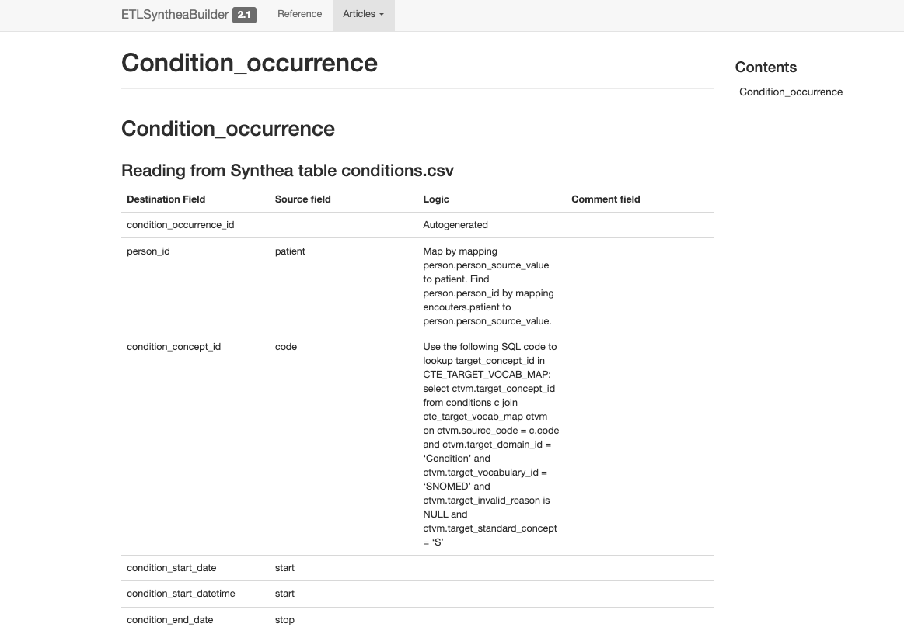
CONDITION_OCCURRENCE
Check the raw data to understand domain movement of codes.
Data in the native “conditions” table will go to the table based on the domain of the mapped standard concept
https://ohdsi.github.io/ETL-Synthea/articles/condition_occurrence.html

Slide 91
Synthea Tables
File | Description
allergies.csv | Patient allergy data.
careplans.csv | Patient care plan data, including goals.
claims.csv | Patient claim data.
claims_transactions.csv | Transactions per line item per claim
conditions.csv | Patient conditions or diagnoses.
devices.csv | Patient-affixed permanent and semi-permanent devices.
encounters.csv | Patient encounter data.
imaging_studies.csv | Patient imaging metadata.
immunizations.csv | Patient immunization data.
medications.csv | Patient medication data.
observations.csv | Patient observations including vital signs and lab reports.
organizations.csv | Provider organizations including hospitals.
patients.csv | Patient demographic data.
payer_transitions.csv | Payer Transition data (i.e. changes in health insurance).
payers.csv | Payer organization data.
procedures.csv | Patient procedure data including surgeries.
providers.csv | Clinicians that provide patient care.
supplies.csv | Supplies used in the provision of care.

Slide 92
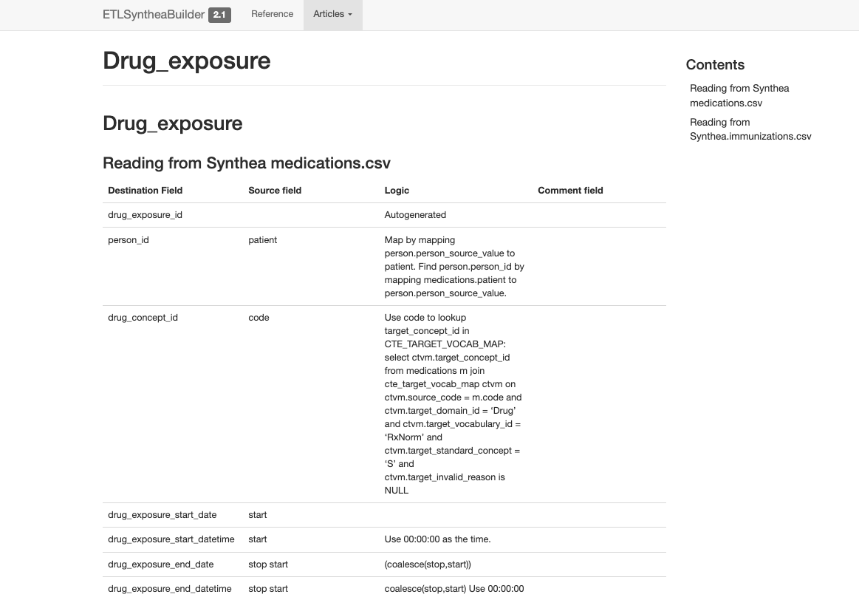
DRUG_EXPOSURE
Use type concepts to denote between ordered, administered, dispensed drugs
https://ohdsi.github.io/ETL-Synthea/articles/drug_exposure.html

Slide 93
Case study example
Notes:
Synthea is really clean, here is an example of how the data actually looks in the real world. Frankenstein

Slide 94
Generating a CDM

Slide 95
ETL Process
ETL Documentation
ETL
Data experts and CDM experts together design the ETL
People with medical knowledge create the code mappings
All are involved in quality control
A technical person implements the ETL
OHDSI Tools
White
Rabbit
Rabbit In a Hat
Usagi
White
Rabbit
ACHILLES
DQD
Rabbit In a Hat
Notes:
Turning the specs into code

Slide 96
ETL Implementation - Considerations
Where is my data? How is it stored?
What is the size of my data?
How complex is my data?
What systems do I need access to?
Do I need to access multiple systems?
Are standard vocabularies represented in my data already?
Do I need to consult someone with clinical expertise?
How often do I need to refresh my CDM?
What tools do I have access to?
What tools do I need access to?
Notes:
Before we start coding, we need to find answers for these questions!
Data location: on-premise, on cloud; data warehouse, data lake; DBMS
Data size: big data not fit in the RAM, distributed
Permission: secure environment

Slide 97










ETL Implementation - Tools
There are multiple tools available to implement your ETL
Tools | Strengths | Limitations
1. Custom scripts (e.g., SQL, Python, R, Java, C#) | Full flexibility, low barrier to develop, full control of dependencies (security concerns) | Difficult to develop, make changes, maintain (technical debt)
2. Commercial ETL tools (MS SSIS, Talend, Pentaho) | Many orgs may have these tools implemented in other ETL tasks already | Usually GUI-based, difficult to maintain, license can be costly
3. Cloud ETL tools (Azure Data Factory, AWS Glue, GCP Cloud Dataflow, Dataform) | Good integrations with existing cloud platforms | May have limited transformation capabilities, some learning curve, cost money every time it runs
4. Modern Open-source Data Transformation tools (dbt est. 2016, SQLMesh est. 2023) | Features rich, good developer experience, relatively easier to maintain, usually free of charge | Features vary, tool support vary, some learning curve, may need to pair with other E & L tools + Orchestrator
Notes:
Your next question might be: Okay, I know the order I should get started in, what should I use?
Misconception: OHDSI’s primary language is R, we don’t need to use R in the ETL
In the example today we are going to demo a simple builder using SQL and R called ETL Synthea. You can use the general principle of etl synthea as a process on how to get started with your own ETL.

Slide 98
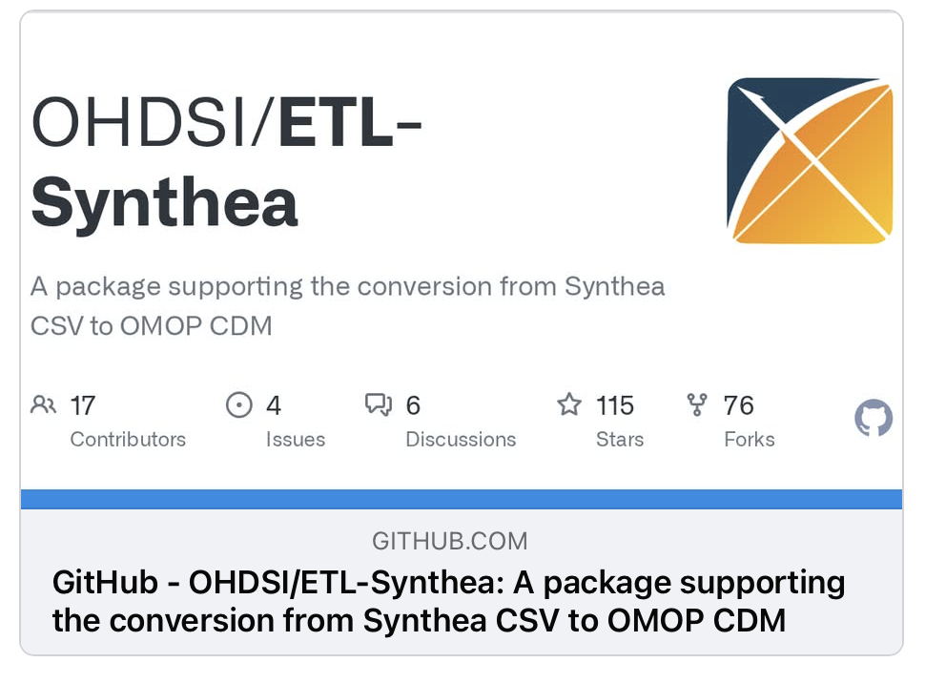
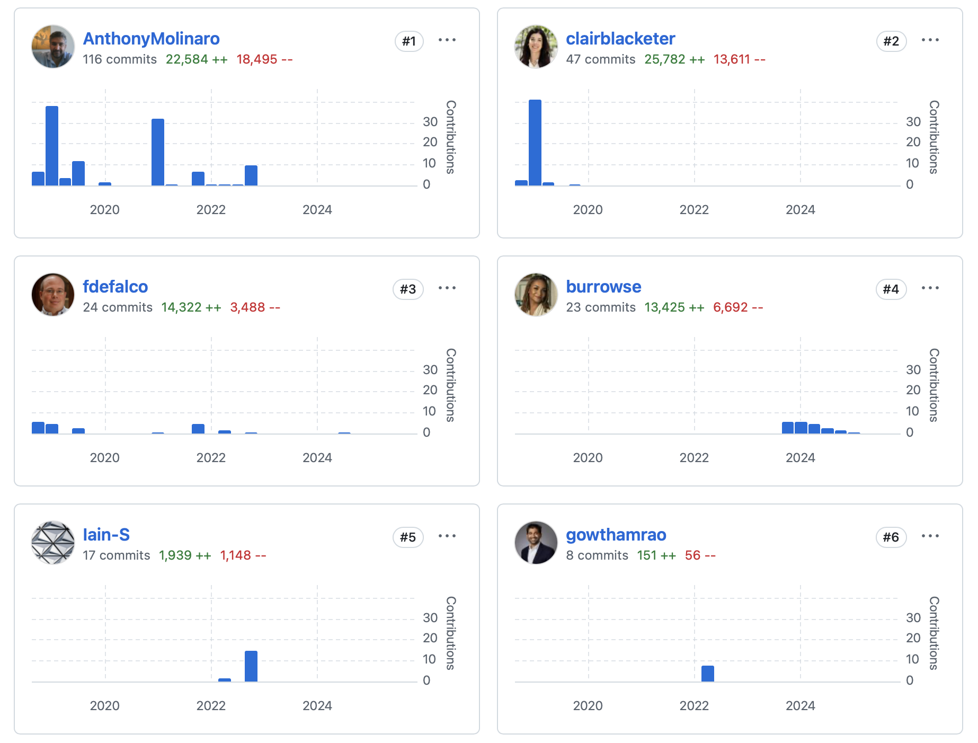
OHDSI/ETL-Synthea
R based ETL Tool
Converts Synthea > OMOP
Synthea v2.7 – v3.3
OMOP v5.3 and v5.4
OHDSI Databases Supported
https://github.com/OHDSI/ETL-Synthea/releases/tag/v2.1.0
Notes:
Thanks the creators & contributors.

Slide 99
What do I need to get started?
R & R Studio
OMOP Vocabulary Files
Synthea data
Your Database
https://github.com/OHDSI/Tutorial-ETL
Notes:
We put the data and instructions on this GitHub repo.
Today, we will use DuckDB to demo.

Slide 100
Running ETL- Synthea
Download and install the package
Define your parameters and create your connection to your database
Create table shells for your Synthea data and OMOP CDM
Load your Synthea data files into the database
Load your Vocabulary data files into the database
Execute your ETL!

Slide 101

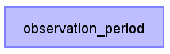
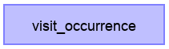
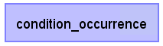




ETL Implementation
General Flow of Implementation
A good rule of thumb is to always create the PERSON table first
The VISIT_OCCURRENCE table must be created before the standardized clinical data tables as they all refer to the VISIT_OCCURRENCE_ID
Additional clinical data tables…
Notes:
First question you might have is: I have my logic written how do I get started?
Not only does it make sense because person_id and visit_occurrence_ids are foreign keys in each of the tables, you also are able to answer a lot of questions very quickly this way.
- Who is in my data set? What are their demographics? How long are they observed continuously in the data? What types of visit settings are they seen in most frequently?

Slide 102



ETL Implementation
General Flow of Implementation
A good rule of thumb is to always create the PERSON table first
The VISIT_OCCURRENCE table must be created before the standardized clinical data tables as they all refer to the VISIT_OCCURRENCE_ID
Vocab & concept tables
Additional clinical data tables…
Notes:
It is a good idea to create the dimensional tables (PROVIDER, LOCATION, CARE_SITE) at the same time as PERSON
Also, get the vocab & concept tables in place. If you have local concepts from Usagi, load them into the database as well.

Slide 103

ETL Implementation
First, let us review the logic we decided on for how the PERSON table should be created.
Navigate in your browser to: https://ohdsi.github.io/ETL-Synthea/articles/person.html

Slide 104




ETL Implementation
First, let’s review the logic we decided on for how the PERSON table should be created.
Gender:
Birthdate:
Race:
Ethnicity:
https://ohdsi.github.io/ETL-Synthea/articles/person.html

Slide 105
Let’s explore SQL for PERSON table!
To open the query while we review:
https://github.com/OHDSI/Tutorial-ETL
etl → etl-synthea → scroll down to step 8 & click insert_person.sql link
It’ll bring you to the original script in ETL-Synthea package: https://github.com/OHDSI/ETL-Synthea/blob/main/inst/sql/sql_server/cdm_version/v540/insert_person.sql

Slide 106


1. Simple logical standard concept mapping
5. Insert data into OMOP Person table with data from the SELECT statement below
2. Common Table Expression (CTE) that fill in full US state name to the location table
3. Map patient location_id based on their city, state, zip.
Use similar JOIN approach for other standard concept mapping (condition, drug, procedure, …)
4. 0 as default for no concept_id
Notes:
Note on dependencies: synthea.patients, cdm.location, cdm.states_map

Slide 107

Table-level Data Lineage
Notes:
You can either manually order your SQL execution or use Data Transformation tools that automatically build the lineage based on the references in SQL scripts

Slide 108
These SQL files need ordered execution + management
Tools | Transformation Runner | Test (before DQD)
ETL-Synthea | R scripts to call the SQL scripts (https://github.com/OHDSI/ETL-Synthea/tree/main/R) & we have to run the R commands in correct order | R scripts (https://github.com/OHDSI/ETL-Synthea/tree/main/extras)
dbt (python lib, but you only need to know SQL) | `dbt run` will automatically trace the Table-level Data Lineage as Directed Acyclic Graph (DAG) via Jinja tags and run SQL scripts for us | `dbt test` will run SQL tests on target tables (https://github.com/OHDSI/dbt-synthea/tree/main/tests/generic)
SQLMesh (python lib, but you only need to know SQL) | `sqlmesh plan` for making changes `sqlmesh run` for filling in changed data Similar to dbt, but have SQL semantic understanding: no need for Jinja, work across multiple DBMS syntax, can trace column-level lineage Stateful virtual data environment: separate dev/prod, not replace old data until successful new run | `sqlmesh audit`similar to dbt (https://github.com/OHDSI/Tutorial-ETL/tree/master/etl/sqlmesh-synthea/audits)

Slide 109


dbt-synthea
https://github.com/OHDSI/Tutorial-ETL/blob/master/etl/dbt-synthea/models/staging/patient_locations.sql
https://github.com/OHDSI/Tutorial-ETL/blob/master/etl/dbt-synthea/models/omop/person.sql

Slide 110


sqlmesh-synthea
https://github.com/OHDSI/Tutorial-ETL/tree/master/etl/sqlmesh-synthea/models/staging
https://github.com/OHDSI/Tutorial-ETL/blob/master/etl/sqlmesh-synthea/models/omop/person.sql

Slide 111

The full DAG can get very complicated!
Tools like dbt & sqlmesh make sure everything gets executed in the right order.
We don’t have to execute everything all the time. We can select a model and its upstream and/or downstream.

Slide 112
Resources
The full Synthea builder can be found here:
https://github.com/OHDSI/ETL-Synthea
dbt-synthea: https://github.com/OHDSI/dbt-synthea (in development)
sqlmesh-synthea: https://github.com/OHDSI/sqlmesh-synthea (in development)
Another example of a R/SQL builder for a much larger database:
https://github.com/OHDSI/ETL-HealthVerityBuilder
A builder created using .NET:
https://github.com/OHDSI/ETL-CDMBuilder
A builder created using the AWS lambda functionality:
https://github.com/OHDSI/ETL-lambdabuilder (in development)

Slide 113
Example Builder: Janssen CDM Builder Over Time
Simple
Simple SQL Queries
Sophisticated
C# Single Machine
Simple SQL Queries + Cursors
SAS Builder
C# Multiple Machine
C# in Cloud Enabled Environment
Data Experts & CDM Experts
Data Experts & CDM Experts
Technical Experts
https://github.com/OHDSI/ETL-CDMBuilder

Slide 114
Usagi
Sneak peek Usagi-on-the-Web (functionally similar to Usagi)
Output -> ETL
TODO

Slide 115
Evaluating a CDM ETL & Data Quality

Slide 116

Evaluation Tools & Processes
Goal: Make sure an OMOP ETL functions as expected and produces a specification-compliant OMOP CDM.
SDLC best practices
RiaH Test Framework
DataQualityDashboard
ACHILLES
ARES

Slide 117

RiaH Test Framework
Before running your ETL, testing your CDM builder is important:
ETL is often complex, increasing the danger of making mistakes that go unnoticed
Source data structure/contents can change over time
Rabbit-In-a-Hat can generate a test framework to facilitate creating small pieces of code that can automatically check ETL logic

Slide 118


Examples of end-to-end / Unit tests
Unimodal – has the OMOP record created?
Multimodal – is also the vocabulary mapping as expected?
Notes:
+ specific filtering rules (e.g. dates in the future, logic for missing data, e.g.)

Slide 119

DataQualityDashboard
R package
https://github.com/OHDSI/ DataQualityDashboard
Part of the HADES suite
27 data quality check types --> around 2,000 individual data quality checks (v2.8.0)
Results exported to json, csv, or database table, and can be explored in an R Shiny application
Depending on inclusion of vocab/result tables, and concept-level checks.

Slide 120

DataQualityDashboard
Notes:
This is what the result of four checks looks like in the Dashboard. It has a failure status, name, description and percentage of records failed.

Slide 121
Data quality check definition
An aggregated summary statistic that can be computed against a dataset and to which a decision threshold can be applied to determine if the statistic meets expectations.
Blacketer, Clair and Williams, Andrew. 2019. Data Quality. https://www.ohdsi.org/wp-content/uploads/2019/09/2-Plenary-1-OMOP-DQ-Clair-Andrew.pdf
Notes:
But let’s take a step back, how do we define a DQ check? Quoting Clair.

Slide 122
Data quality check definition
An aggregated summary statistic that can be computed against a dataset and to which a decision threshold can be applied to determine if the statistic meets expectations.
Blacketer, Clair and Williams, Andrew. 2019. Data Quality. https://www.ohdsi.org/wp-content/uploads/2019/09/2-Plenary-1-OMOP-DQ-Clair-Andrew.pdf
Notes:
Zoom in on the first part

Slide 123
Data quality check example 1
The number and percent of records with a value in the DAYS_SUPPLY field of the DRUG_EXPOSURE table less than 0.
Blacketer, Clair and Williams, Andrew. 2019. Data Quality. https://www.ohdsi.org/wp-content/uploads/2019/09/2-Plenary-1-OMOP-DQ-Clair-Andrew.pdf

Slide 124
Data quality check example 1 - Generalized
The number and percent of records with a value in the CDM field of the CDM table less than a low value.
Check Name: plausibleValueLow
Blacketer, Clair and Williams, Andrew. 2019. Data Quality. https://www.ohdsi.org/wp-content/uploads/2019/09/2-Plenary-1-OMOP-DQ-Clair-Andrew.pdf

Slide 125
Data quality check example 2
The number and percent of records which are not mapped into a standard concept in the CONDITION_CONCEPT_ID field of the CONDITION_OCCURRENCE table.
Blacketer, Clair and Williams, Andrew. 2019. Data Quality. https://www.ohdsi.org/wp-content/uploads/2019/09/2-Plenary-1-OMOP-DQ-Clair-Andrew.pdf

Slide 126
Data quality check example 2 - Generalized
The number and percent of records which are not mapped into a standard concept in the CDM field of the CDM table.
Check Name: standardConceptRecordCompleteness
Blacketer, Clair and Williams, Andrew. 2019. Data Quality. https://www.ohdsi.org/wp-content/uploads/2019/09/2-Plenary-1-OMOP-DQ-Clair-Andrew.pdf

Slide 127

Data quality check types
Blacketer, Clair and Williams, Andrew. 2019. Data Quality. https://www.ohdsi.org/wp-content/uploads/2019/09/2-Plenary-1-OMOP-DQ-Clair-Andrew.pdf
Notes:
That is why each check is phrased very specifically.

Slide 128
Templates for 25 Check Types
Conformance
Primary Key
Foreign Key
Data type
CDM Field Exists
CDM Table Exists
Required Field
Standard Valid Concept
Domain
Class
Completeness
Records per person
Field value
Standard Concept
Source Concept
Source Value
Condition Era
Plausibility
Gender (x2)
Low Value
High Value
Unit concept
After birth
Before death
Start before End
Within Visit
To be deprecated:
Temporal After
During Life
Database constraints
Needs external information (validation)
Notes:
First in conformance basically check whether Database constraints are applied correctly.
Conformance Standard concept vs completeness standard concept.
Per OMOP conventions, target concept should be valid and standard. This is what conformance check does.
Target concept can be 0, meaning ‘unmapped’. The number of unmapped concept is what completeness check does.
Low/High value both for numeric results and for dates
Most checks are verification (within db).
Gender and low/high value are examples of validation where result needs to be compared to external benchmark.

Slide 129
Number of checks by name
checkLevel category checkName n
1 CONCEPT Plausibility plausibleGender 287
2 CONCEPT Plausibility plausibleGenderUseDescendants 4
3 CONCEPT Plausibility plausibleUnitConceptIds 181
4 FIELD Completeness measureValueCompleteness 305
5 FIELD Completeness standardConceptRecordCompleteness 45
6 FIELD Completeness sourceConceptRecordCompleteness 14
7 FIELD Completeness sourceValueCompleteness 32
8 FIELD Conformance cdmField 305
9 FIELD Conformance isRequired 106
10 FIELD Conformance cdmDatatype 148
11 FIELD Conformance isPrimaryKey 21
12 FIELD Conformance isForeignKey 136
13 FIELD Conformance fkDomain 32
14 FIELD Conformance fkClass 2
15 FIELD Conformance isStandardValidConcept 52
16 FIELD Plausibility plausibleValueLow 55
17 FIELD Plausibility plausibleValueHigh 47
18 FIELD Plausibility plausibleTemporalAfter 41
19 FIELD Plausibility plausibleDuringLife 28
20 FIELD Plausibility withinVisitDates 9
21 FIELD Plausibility plausibleAfterBirth 43
22 FIELD Plausibility plausibleBeforeDeath 41
23 FIELD Plausibility plausibleStartBeforeEnd 15
24 TABLE Completeness measurePersonCompleteness 16
25 TABLE Completeness measureConditionEraCompleteness 1
26 TABLE Conformance cdmTable 23
27 TABLE Plausibility measureObservationPeriodOverlap 1
checkLevel category checkName n
1 CONCEPT Plausibility plausibleGender 287
2 CONCEPT Plausibility plausibleGenderUseDescendants 4
3 CONCEPT Plausibility plausibleUnitConceptIds 181
4 FIELD Completeness measureValueCompleteness 391
5 FIELD Completeness standardConceptRecordCompleteness 48
6 FIELD Completeness sourceConceptRecordCompleteness 13
7 FIELD Completeness sourceValueCompleteness 32
8 FIELD Conformance cdmField 391
9 FIELD Conformance isRequired 145
10 FIELD Conformance cdmDatatype 197
11 FIELD Conformance isPrimaryKey 23
12 FIELD Conformance isForeignKey 163
13 FIELD Conformance fkDomain 43
14 FIELD Conformance fkClass 3
15 FIELD Conformance isStandardValidConcept 64
16 FIELD Plausibility plausibleValueLow 68
17 FIELD Plausibility plausibleValueHigh 60
18 FIELD Plausibility plausibleTemporalAfter 51
19 FIELD Plausibility plausibleDuringLife 34
20 FIELD Plausibility withinVisitDates 9
21 FIELD Plausibility plausibleAfterBirth 49
22 FIELD Plausibility plausibleBeforeDeath 47
23 FIELD Plausibility plausibleStartBeforeEnd 22
24 TABLE Completeness measurePersonCompleteness 16
25 TABLE Completeness measureConditionEraCompleteness 1
26 TABLE Conformance cdmTable 31
27 TABLE Plausibility measureObservationPeriodOverlap 1

Slide 130
Data quality check definition
An aggregated summary statistic that can be computed against a dataset and to which a decision threshold can be applied to determine if the statistic meets expectations.
Blacketer, Clair and Williams, Andrew. 2019. Data Quality. https://www.ohdsi.org/wp-content/uploads/2019/09/2-Plenary-1-OMOP-DQ-Clair-Andrew.pdf

Slide 131
Data quality check definition
An aggregated summary statistic that can be computed against a dataset and to which a decision threshold can be applied to determine if the statistic meets expectations.
Blacketer, Clair and Williams, Andrew. 2019. Data Quality. https://www.ohdsi.org/wp-content/uploads/2019/09/2-Plenary-1-OMOP-DQ-Clair-Andrew.pdf

Slide 132


Data quality check thresholds
An aggregated summary statistic that can be computed against a dataset and to which a decision threshold can be applied to determine if the statistic meets expectations.
DON'T ACT
ACT
0% of records failed the DQ check
THRESHOLD
100% of records failed the DQ check

Slide 133
Data quality check thresholds
Fatal checks: Threshold is always 0
CDM convention checks: Threshold should be 0 in theory, but may need to be adjusted in practice
Characterization checks: Threshold depends on expectations of the data source*
DON'T ACT
ACT
0% of records failed the DQ check
THRESHOLD
100% of records failed the DQ check
*and the analytic use case

Slide 134

Applying the check thresholds
% of records that violate check
0% = any violation → FAIL
100% = always PASS
Notes:
How do we determine a check result is good enough?
Result should be lower than the threshold.
DQD comes with its own predefined thresholds.

Slide 135

Check-level documentation
https://ohdsi.github.io/DataQualityDashboard/

Slide 136
DQD Demo

Slide 137


ACHILLES
R package
https://github.com/OHDSI/Achilles
Part of the HADES suite
Provides descriptive statistics on an OMOP CDM
Person/concept counts, stratified by month, age, gender.
Distribution of numeric values
Results can be visualized in ARES or ATLAS-Data Sources
Notes:
Atlas Data Sources might be well know, so we will show Ares

Slide 138


ARES
Application for exploring ACHILLES and DataQualityDashboard results
https://github.com/OHDSI/ares
Features for assessing data quality and database characteristics.
Single release
Across releases for an individual database
Across databases within a network

Slide 139
Ares Demo
Notes:
One database, one release. Our NJ dataset we started with.
Data Source Overview not that interesting,
Lets open the sept 2025 release
We see a person report, characterising our 109 individuals stratified by age, gender, race.
**Note this is all precomputed, we cannot interactively create new stratifications, or combine them.
Data density – highlight measurement, zoom in on last years. Records per month. Hover over.
**Useful for trends in time, e.g. in many databases you will see the covid lockdown dips.
Visit occurrence – sort by person%
** this very nicely characterises the data. All have outpatient, but many inpatient and ER as well. Quite critical group of people. None healthy?
Measurement – click heart rate, see value distribution
Lastly: DQ in Ares, little nicer viewer than in

Slide 140
Ares requirements
Run Achilles
Run DQD
Run Ares Export (part of Achilles package)
Move DQD json file to Ares Export
Run AresIndexer(s)
Host Ares server (locally, or central infrastructure)
To compare, for DQD Viewer:
Run DQD
Launch Shiny app viewDqDashboard(json_path)
Notes:
Before you think, ditch DQD viewer, it requires multiple steps to get Ares working.

Slide 141


Extending Data Quality Assessment for DARWIN EU® - CdmOnboarding
Word doc with OMOP CDM database characteristics:
Table counts
Concept mapping coverage
Top mapped/unmapped concepts
Data Density and Date ranges
Drug Exposure Diagnostics summary
Database Performance
Infrastructure
https://github.com/darwin-eu/ CdmOnboarding
Notes:
Easily shareable, easily reviewable.

Slide 142


ETL Maintenance
ETL Documentation
Changed or Updated Raw Data?
ETL
Bug Found?
Updated CDM
New Vocab?
All are involved in quality control
A technical person implements the ETL
CDM Update?

Slide 143

Achilles
This plot shows that the bulk of the data starts in 2005. However, there also appear to be a few records from around 1961, which is likely an error in the data.

Slide 144

Achilles
This change coincides with changes in the reimbursement rules in this specific country, leading to more diagnoses but probably not a true increase in prevalence in the underlying population.

Slide 145

Issues in our synthetic data?
cdm_synthea
Did our test cases run?

Slide 146

Issues in our synthetic data?
cdm_synthea
Did Achilles notice anything?

Slide 147

Issues in our synthetic data?
cdm_synthea
Did DQD notice anything?

Slide 148

Maybe we have a bug?
In the CONDITION_OCCURRENCE, 61% rows are mapped to 0

Slide 149

Document the Bug

Slide 150

Vocabulary to fix the problem

Slide 151
Vocabulary to fix the problem
WITH CTE_VOCAB_MAP AS (
SELECT c.concept_code AS SOURCE_CODE, c.concept_id AS SOURCE_CONCEPT_ID, c.concept_name AS SOURCE_CODE_DESCRIPTION,
c.vocabulary_id AS SOURCE_VOCABULARY_ID, c.domain_id AS SOURCE_DOMAIN_ID, c.CONCEPT_CLASS_ID AS SOURCE_CONCEPT_CLASS_ID,
c.VALID_START_DATE AS SOURCE_VALID_START_DATE, c.VALID_END_DATE AS SOURCE_VALID_END_DATE, c.INVALID_REASON AS SOURCE_INVALID_REASON, c1.concept_id AS TARGET_CONCEPT_ID, c1.concept_name AS TARGET_CONCEPT_NAME, c1.VOCABULARY_ID AS TARGET_VOCABUALRY_ID,
c1.domain_id AS TARGET_DOMAIN_ID, c1.concept_class_id AS TARGET_CONCEPT_CLASS_ID, c1.INVALID_REASON AS TARGET_INVALID_REASON, c1.standard_concept AS TARGET_STANDARD_CONCEPT
FROM CONCEPT C
JOIN CONCEPT_RELATIONSHIP CR
ON C.CONCEPT_ID = CR.CONCEPT_ID_1
AND CR.invalid_reason IS NULL
AND cr.relationship_id = 'Maps to'
JOIN CONCEPT C1
ON CR.CONCEPT_ID_2 = C1.CONCEPT_ID
AND C1.INVALID_REASON IS NULL
UNION
SELECT source_code, SOURCE_CONCEPT_ID, SOURCE_CODE_DESCRIPTION, source_vocabulary_id, c1.domain_id AS SOURCE_DOMAIN_ID, c2.CONCEPT_CLASS_ID AS SOURCE_CONCEPT_CLASS_ID,c1.VALID_START_DATE AS SOURCE_VALID_START_DATE,
c1.VALID_END_DATE AS SOURCE_VALID_END_DATE, stcm.INVALID_REASON AS SOURCE_INVALID_REASON,target_concept_id,
c2.CONCEPT_NAME AS TARGET_CONCEPT_NAME, target_vocabulary_id, c2.domain_id AS TARGET_DOMAIN_ID,
c2.concept_class_id AS TARGET_CONCEPT_CLASS_ID, c2.INVALID_REASON AS TARGET_INVALID_REASON,
c2.standard_concept AS TARGET_STANDARD_CONCEPT
FROM source_to_concept_map stcm
LEFT OUTER JOIN CONCEPT c1
ON c1.concept_id = stcm.source_concept_id
LEFT OUTER JOIN CONCEPT c2
ON c2.CONCEPT_ID = stcm.target_concept_id
WHERE stcm.INVALID_REASON IS NULL
)
SELECT TARGET_CONCEPT_ID, TARGET_CONCEPT_NAME, TARGET_DOMAIN_ID
FROM CTE_VOCAB_MAP
WHERE SOURCE_VOCABULARY_ID = ‘Synthea_conditions'
Look in the Source to Concept Map table for a map

Slide 152

Update the ETL document
https://ohdsi.github.io/Tutorial-ETL/docs/cdm_synthea_v2

Slide 153

Re-run the DQD
TBD

Slide 154


Re-run Achilles

Slide 155

Final Hard Lessons Learned

Slide 156


80/20 Rule
You don’t need to map all terms to get good data coverage!

Slide 157
Comfort with Data Loss
If there is data that is not of research quality or there are methods to adjust, use the ETL to standardize that
Example Patient Drop Counts from a CDM Build
Reason to Drop Someone | Person Count
Unknown gender | 23,592
Implausible year of birth - past | 749
Implausible year of birth - records before birth | 3,836
Gender changes | 2

Slide 158
ETL Process
ETL Documentation
ETL
Data experts and CDM experts together design the ETL
People with medical knowledge create the code mappings
All are involved in quality control
A technical person implements the ETL
OHDSI Tools
White
Rabbit
Rabbit In a Hat
Usagi
White
Rabbit
ACHILLES
DQD
Rabbit In a Hat

Slide 159
Lastly: Continuous ETL Maintenance
ETL Documentation
Changed or Updated Raw Data?
ETL
Bug Found?
Updated CDM
New Vocab?
All are involved in quality control
A technical person implements the ETL
CDM Update?

Slide 160



Further Reading: the ETL Process
Erica A Voss, Clair Blacketer, Sebastiaan van Sandijk, Maxim Moinat, Michael Kallfelz, Michel van Speybroeck, Daniel Prieto-Alhambra, Martijn J Schuemie, Peter R Rijnbeek, European Health Data & Evidence Network—learnings from building out a standardized international health data network, Journal of the American Medical Informatics Association, Volume 31, Issue 1, January 2024, Pages 209–219, https://doi.org/10.1093/jamia/ocad214
Blacketer C, Voss EA, DeFalco F, Hughes N, Schuemie MJ, Moinat M, Rijnbeek PR. Using the Data Quality Dashboard to Improve the EHDEN Network. Applied Sciences. 2021; 11(24):11920. https://doi.org/10.3390/app112411920

Slide 161
Take home message
“While study-specific checks should still be run, we recommend that all data holders converting their data to the OMOP CDM use the DQD as it ensures conformance to the model specifications and that a database meets a baseline level of completeness and plausibility for use in research.”
Blacketer C, Voss EA, DeFalco F, Hughes N, Schuemie MJ, Moinat M, Rijnbeek PR. Using the Data Quality Dashboard to Improve the EHDEN Network. Applied Sciences. 2021; 11(24):11920. https://doi.org/10.3390/app112411920

